Slide 1
Met Council Regional Framework Stakeholder Input
Vayong Moua, MPA
Senior Advocacy Consultant
Center for Prevention, Blue Cross and Blue Shield of MN
The Opportunity to Improve Health and Equity 4.4.12

Slide 2
Obesity Trends* Among U.S. Adults
(BMI ≥30, or about 30 lbs. overweight for 5’4” person)
1990
No Data <10% 10%–14% 15%–19% 20%–24% 25%–29% ≥30%
*Source: CDC Behavioral Risk Factor Surveillance System

Slide 3
Obesity Trends* Among U.S. Adults
(BMI ≥30, or about 30 lbs. overweight for 5’4” person)
1998
No Data <10% 10%–14% 15%–19% 20%–24% 25%–29% ≥30%
*Source: CDC Behavioral Risk Factor Surveillance System

Slide 4
Obesity Trends* Among U.S. Adults
(BMI ≥30, or about 30 lbs. overweight for 5’4” person)
2008
No Data <10% 10%–14% 15%–19% 20%–24% 25%–29% ≥30%
*Source: CDC Behavioral Risk Factor Surveillance System

Slide 5
The Master Framework

Slide 6
Policy, Systems, Environmental Change
Tobacco, Healthy Eating, and Active Living
Advocacy: WHO and CDC calls for “political competence” and science
Health Equity Principle and Practice: Opportunity for ALL communities to optimize their health
Education is necessary but insufficient. We need to go upstream.
Notes:
Ex. Of PSE approaches

Slide 7
Notes:
Picture of Ramona and her friends; appear to be walking to school. As a parent, would you feel comfortable with your child walking to school independently or playing in this environment. Right next to the road, looks like high speeds, etc.
So we ask, what is the ideal environment that we want Ramona and her friends to be surrounded by?

Slide 8
Notes:
If our goal is to reduce childhood obesity, we might be inclined to aim a bunch of programs at Ramona.
Singing fruits and vegetables to educate her about the importance of eating healthy.
Pairing her with a personal training to learn exercise techniques.
Giving her family a cookbook so they can learn to cook healthy foods.
Give away water bottles.
Etc. . .

Slide 9
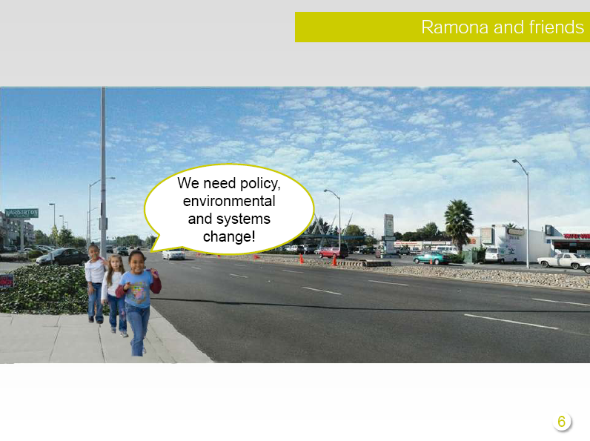
Notes:
But instead of that, what if Ramona and her friends said “We need policy environmental and systems change.” What would that look like?

Slide 10
Notes:
Start to see some important changes in this picture: bus stop, trees, new median, bump out curbs, nice distance between sidewalk and zooming cars

Slide 11
Notes:
And we see even more changes here. Retail on both sides, farmer’s market line indicates that they’re near a farmers market, safer, more inviting walking environment. Sends the right message and “normalizes” walking as the first choice.

Slide 12
Notes:
Now let’s look behind the scenes to see what it took to create these changes. A number of different changes, some big P (complete streets, advertising ban) and some small P (lighting, comprehensive plan). Lots of systems and environmental change.
Obviously these kind of changes don’t happen overnight, but investing in them creates healthier environments for generations to come.

Slide 13
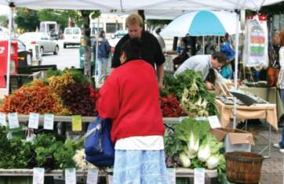
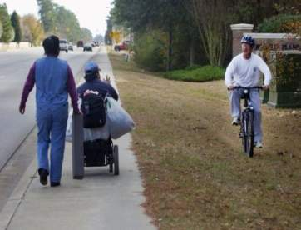
Livable communities can…
Generate two more walk/bike trips per person per week
Prevent up to 1.7 pounds of weight gain per year
Have 35% lower risk of obesity
Increase total minutes of physical activity by 40%
Increase life expectancy by four years
Ewing et al 2003, Saelens et al 2003, Giles-Corti 2003, Frank et al 2003, Sturm et al 2004, Frank et al 2004, Lopez 2004, Morland et al 2002.
Notes:
13
What I will share is what the research says about health benefits of communities with walkable, bikeable features.

Slide 14
Active Living: The Stairway Speech
Active Living = Integration of physical activity into daily life
Land use and zoning policies that support walkable, bikeable, and active communities
Ex. Complete Streets, open/green space, trails, proximity to parks/recreation areas, etc.
Physical Connectivity = Social Connectivity = Health for All
Notes:
PSE approach to PA and Obesity, Not to discount need/import of individual and programmatic interventions…rather complementary

Slide 15
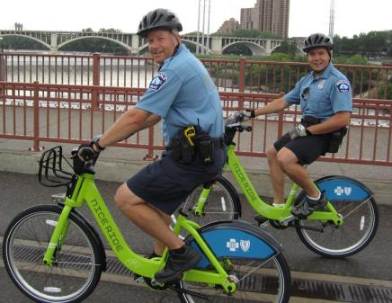
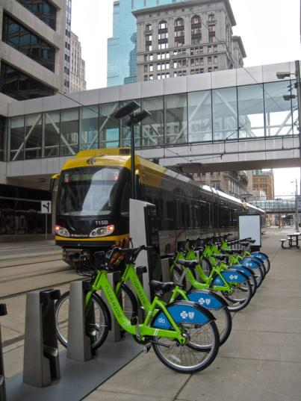
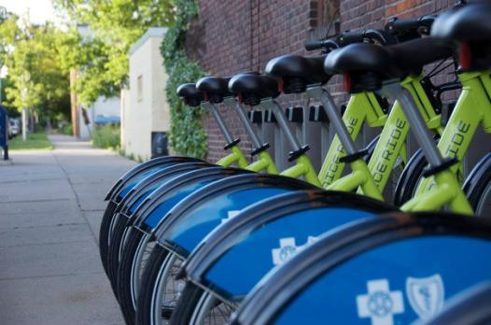
Notes:
15
Build it and Celebrate it
15

Slide 16
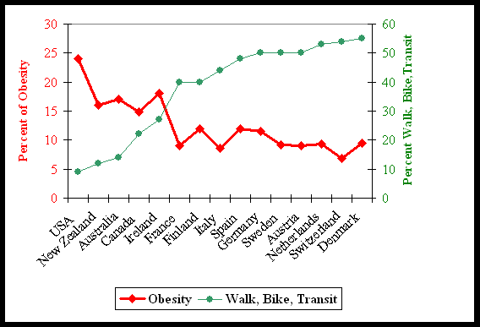
Inverse Correlation: Obesity & Active Transportation
*Provided by National Complete Streets: Pucher Study, 2009
16

Slide 17
What are Complete Streets (CS)?
Complete Streets are designed and operated so they are safe, comfortable, and convenient for all users – pedestrians, bicyclists, motorists and transit riders of
all ages and abilities.

Slide 18
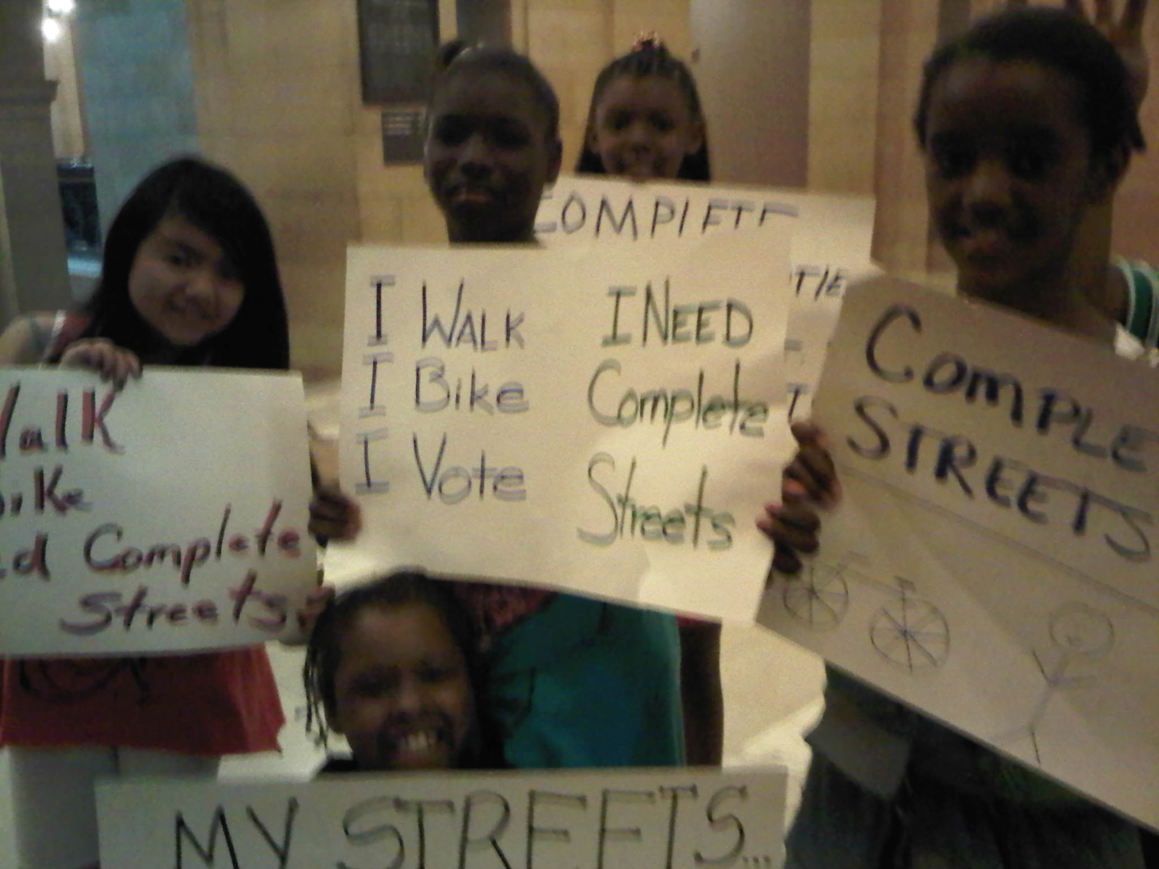
Complete Streets = Complete Communities

Slide 19
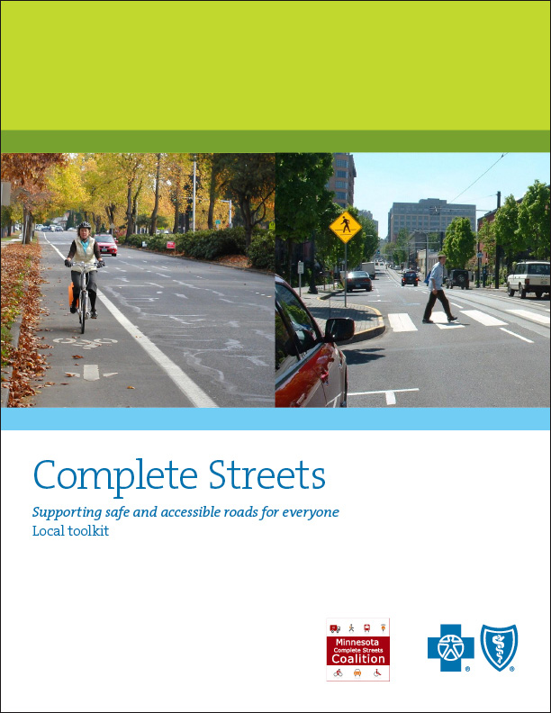
Complete Streets Toolkit: www.mncompletestreets.org

Slide 20
Healthy Eating and Built Environment
Preserving Farmland and Promote Urban Agriculture
Example: Minneapolis Urban Agriculture Policy
“ First time since 1963, people will be allowed to grow food commercially in the City of Minneapolis”
-Cam Gordon, Minneapolis City Council Member, Second Ward
From seed to plate: The food system impacts health (land use, transportation, proximity to grocery stores/farmer’s markets, and affordable healthy foods)

Slide 21
Health and Equity integrated into Decisions
Recommendations from National Prevention Council, US Surgeon General
• Facilitate collaboration among diverse sectors (e.g., planning, housing, transportation, energy, education, environmental regulation, agriculture, business associations, labor organizations, health and public health) when making decisions likely to have a significant effect on health.
• Include health criteria as a component of decision making (e.g., policy making, land use and transportation planning).
• Conduct comprehensive community health needs assessments and develop state and community health improvement plans.

Slide 22
Tools and Examples
Health Impact Assessments: Healthy Corridor for All
Seattle King County Equity Ordinance
Eagan’s Healthy Living Resolution
Nashville MPO

Slide 23
Model:: Incorporating Health in Regional Transportation Planning: Nashville, Tennessee
Recognizing the relationship between the built environment, transportation, and health, the Nashville Area Metropolitan Planning Organization adopted a set of guiding principles, goals, and objectives to help the region pursue quality growth as a central part of its 25-year regional transportation plan.
Emphasizing mass transit, active transportation (e.g., biking, walking), and preservation and enhancement of roadways, the plan incorporates health considerations into infrastructure project selection. - Cited from National Prevention Strategy, US Surgeon General

Slide 24
Nashville MPO Example
Sixty percent of the selection criteria are related to health, safety, congestion reduction, and active transportation, which has resulted in the inclusion of sidewalks, bicycle lanes, or shared-use lanes in 70 percent of funded roadway projects (up from 2 percent).
The plan also reserves a minimum of 25 percent of Federal Surface Transportation Project dollars for active transportation.

Slide 25
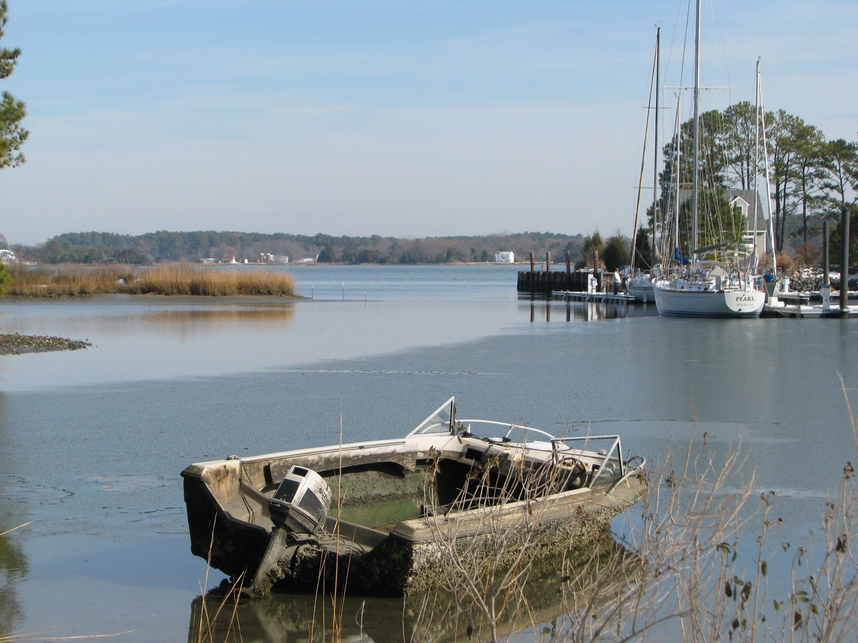
Health Equity: Race and Place Matters
See “The Unequal Distribution of Health” report
Notes:
25

Slide 26
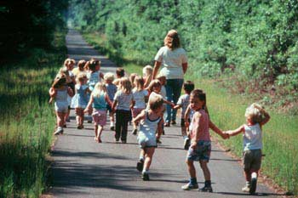
About 1/3 of Americans Do Not Drive
This includes:
21% of Americans over 65.
All children under 16.
Many low income Americans who cannot afford automobiles.
Community members who choose not to or cannot drive
Dan Burden, pedbikeimages.org
26

Slide 27
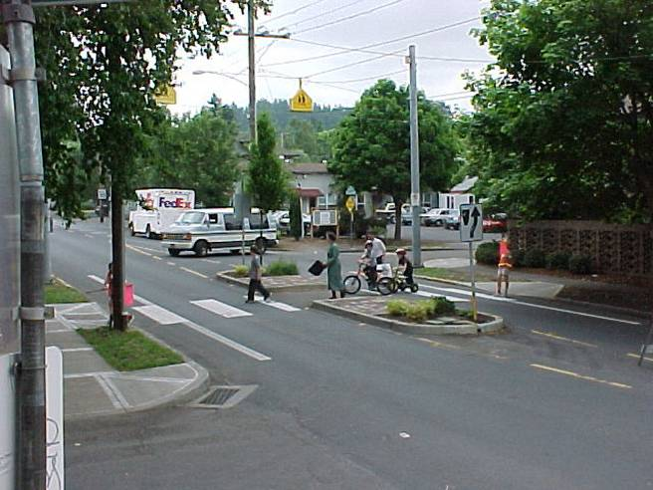
Solutions for Most Vulnerable= Solutions for All
27

Slide 28

Community Competence: Early, Often, and Authentic Engagement of Diverse Communities
Notes:
Effective public participation can help ensure that health equity and sustainability are considered in decision making
(e.g., community planning, zoning, and land use decisions).

Slide 29
Health Equity and Transportation
The Transportation prescription
“ For too long now, our transportation decision making has failed to address the impacts that our infrastructure network has on public health and equity.”
Congressman James Oberstar

Slide 30
Sources
National Prevention Council, National Prevention Strategy, Washington, DC: U.S. Department of Health and Human Services, Office of the Surgeon General, 2011.
The Unequal Distribution of Health, Wilder Foundation, 2010
www.mncompletestreets.org
www.preventionminnesota.com
http://www.unnaturalcauses.org/
Unequal Distribution of Health Report
http://www.bcbsmnfoundation.org/objects/Publications/F9790_web%20-%20Wilder%20full%20report.pdf
The Transportation Prescription Report
http://www.convergencepartnership.org/atf/cf/%7B245a9b44-6ded-4abd-a392-ae583809e350%7D/TRANSPORTATIONRX.PDF

Slide 31
Thank You!
Questions and discussion
Vayong Moua, MPA
Senior Advocacy Consultant
1750 Yankee Doodle Road, s113
Eagan, MN 55121
651-662-9530
Vayong_moua@bluecrossmn.com

