Slide 1
Metropolitan Council
Environmental Services
Info Item 3: Dakota County Trail Plan and MCES Facilities
Presented to the Environment Committee
September 27, 2011
Bryce Pickart, Assistant General Manager, Technical Services
A Clean Water Agency

Slide 2
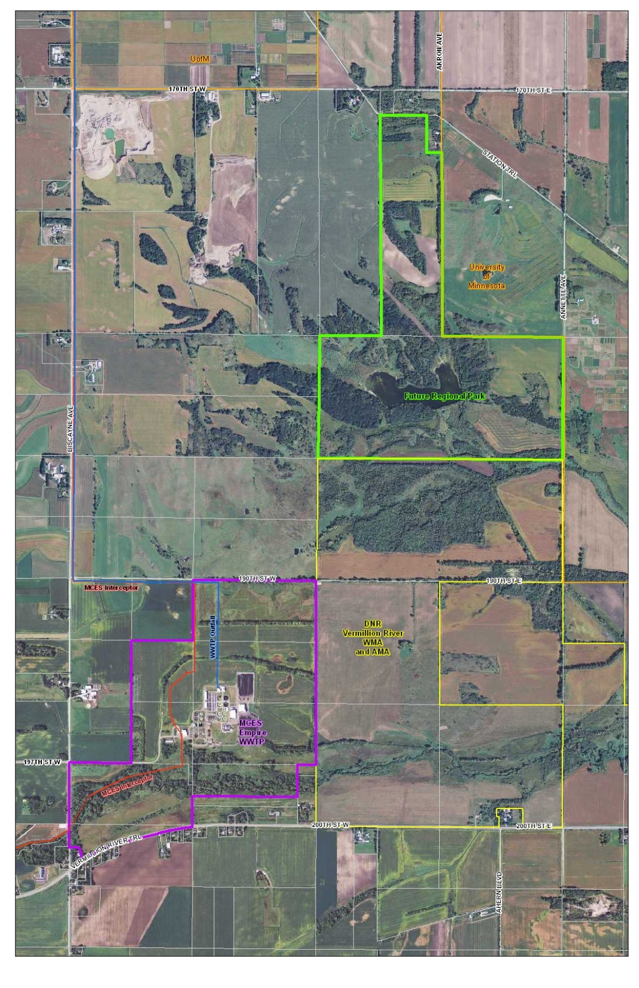

Slide 3
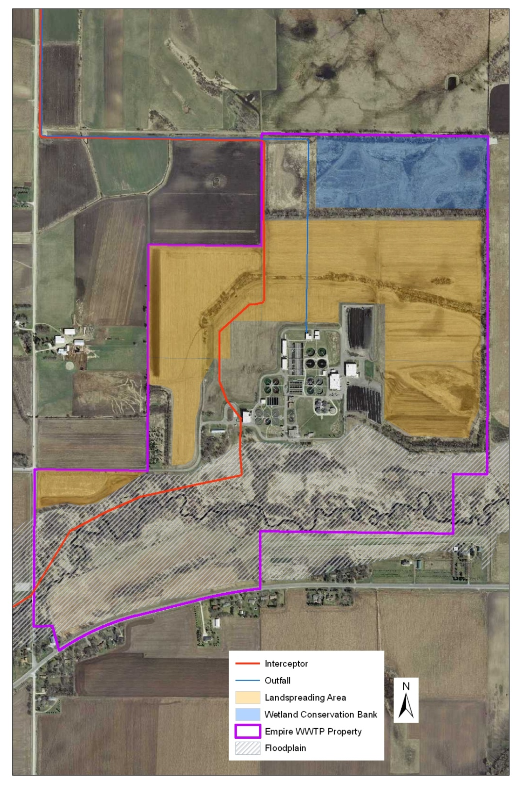

Slide 4
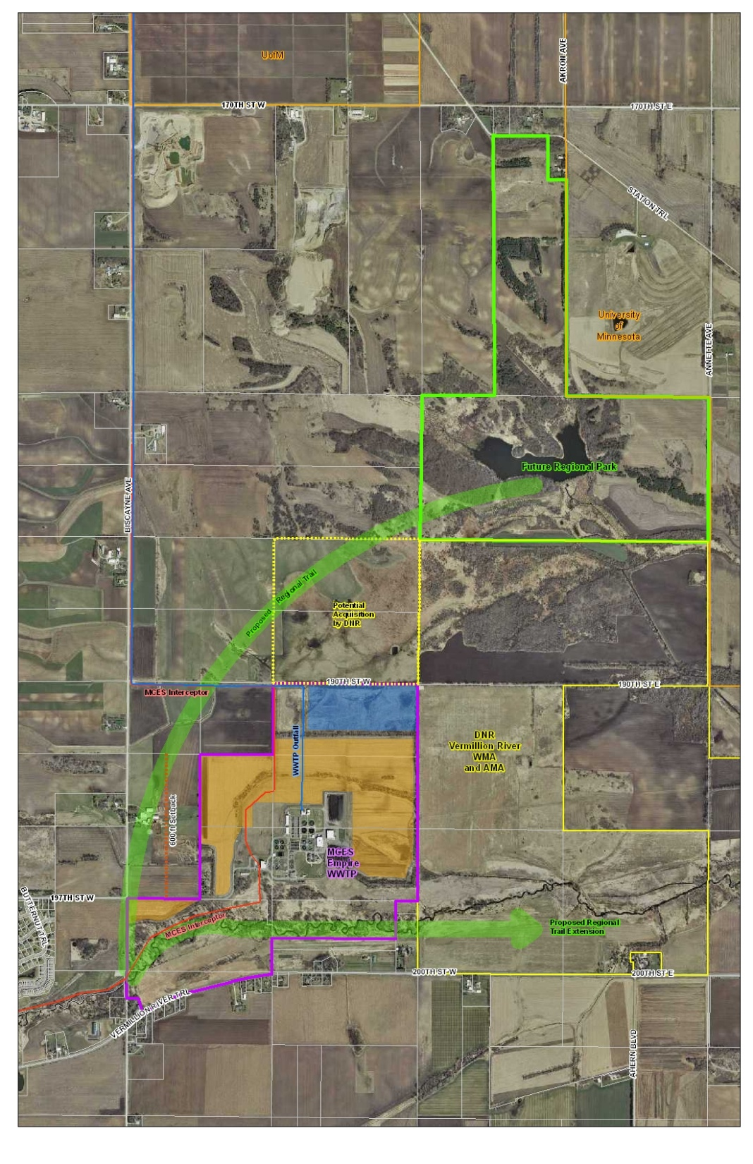

Slide 5
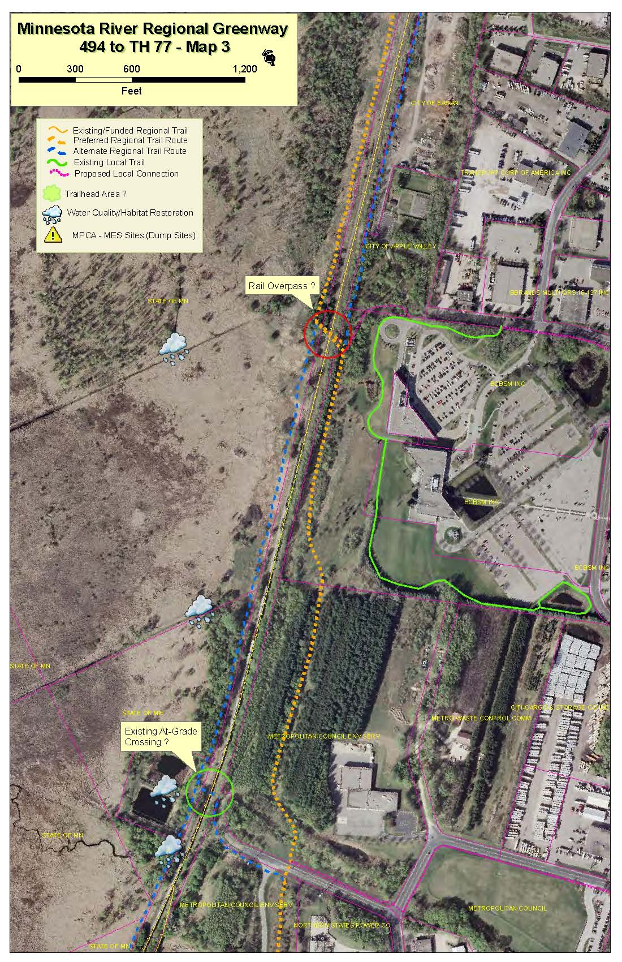

Slide 6
