Slide 1

Metropolitan Council
Environmental Services
Water Supply Work Plan for Clean Water Fund Activities
Environment Committee
September 13, 2011
Keith Buttleman
Assistant General Manager
Lanya Ross
Principal Environmental Scientist
Brian Davis
Senior Environmental Scientist
A Clean Water Agency

Slide 2
Water Supply Planning
The Metropolitan Council analyzes water supply issues in the context of regional growth, supporting wise management decisions that protect Minnesota’s most-used drinking water sources.
Our activities are guided by the Twin Cities Metropolitan Area Master Water Supply Plan.

Slide 3
Water Supply Plan Funding
Initial $2 million from an unused solid waste planning bond
Clean Water, Land, and Legacy Amendment Clean Water Fund appropriations:
  $400,000 in FY 10
  $400,000 in FY 11
  $1,000,000 in FY 12-13 ($500,000 per year)

Slide 4

Clean Water Fund Projects
Thirteen projects
  Four complete
  Four in progress
  Five being developed
$552,900 spent
$1,247,100 remains

Slide 5
Project Work Plan
 | 2010 | 2011 | 2012 | 2013 | 2014
East Bethel Water Availability | ----------
Water Conservation Cost/Benefit | ----------
Groundwater/Surface Water | ----------
Aquifer Property Mapping | ----------
Stormwater Reuse Guidance |  | ----------
Glacial Aquifer Vulnerability |  | ----------
Seminary Fen |  | ---------- | ---------- | ----------
South Washington County |  | ---------- | ---------- | ----------
Rural Source Water Protection |  |  | ---------- | ----------
Recharge Model |  |  | ---------- | ----------
Groundwater Model |  |  | ---------- | ---------- | ----------
Industrial Water Use Efficiency |  |  | ---------- | ---------- | ----------
Stormwater Infiltration BMPs |  |  | ---------- | ---------- | ----------

Slide 6
Assessment of East Bethel Water Availability
$110,200
Complete
Partnered with Braun Intertec and East Bethel
Benefits: water supply planning and sewer service expansion were aligned

Slide 7
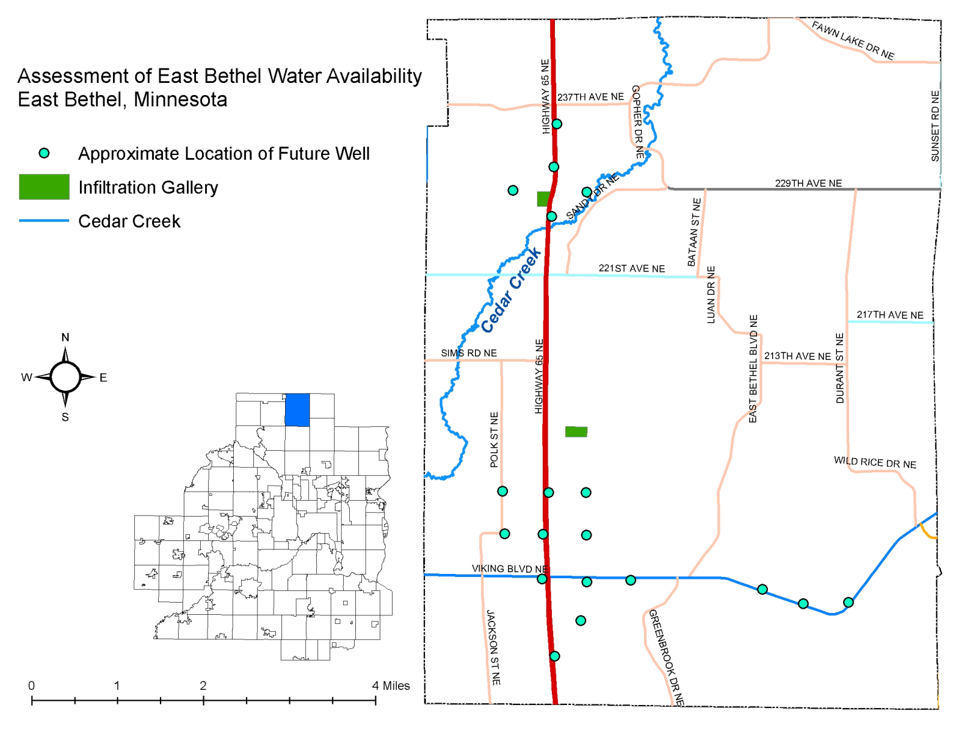
Assessment of East Bethel Water Availability

Slide 8
Cost Benefit Analysis of Water Conservation
$77,000
Complete
Partnered with Environmental Financial Group
Benefits: increased capacity to avoid or delay infrastructure expansion costs by reducing per capita water demand

Slide 9
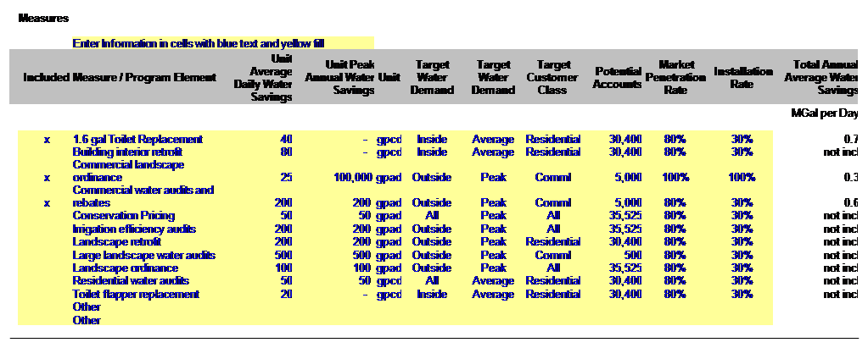
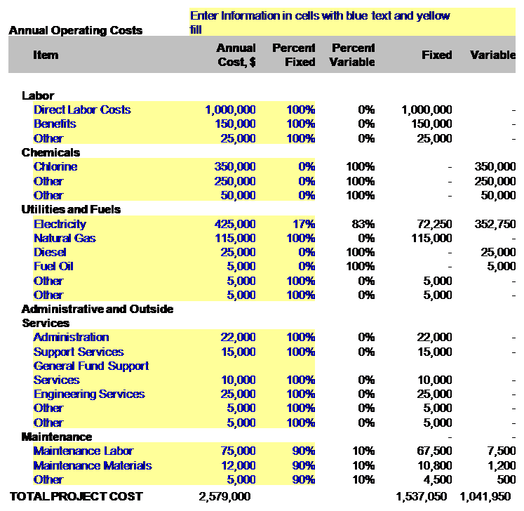
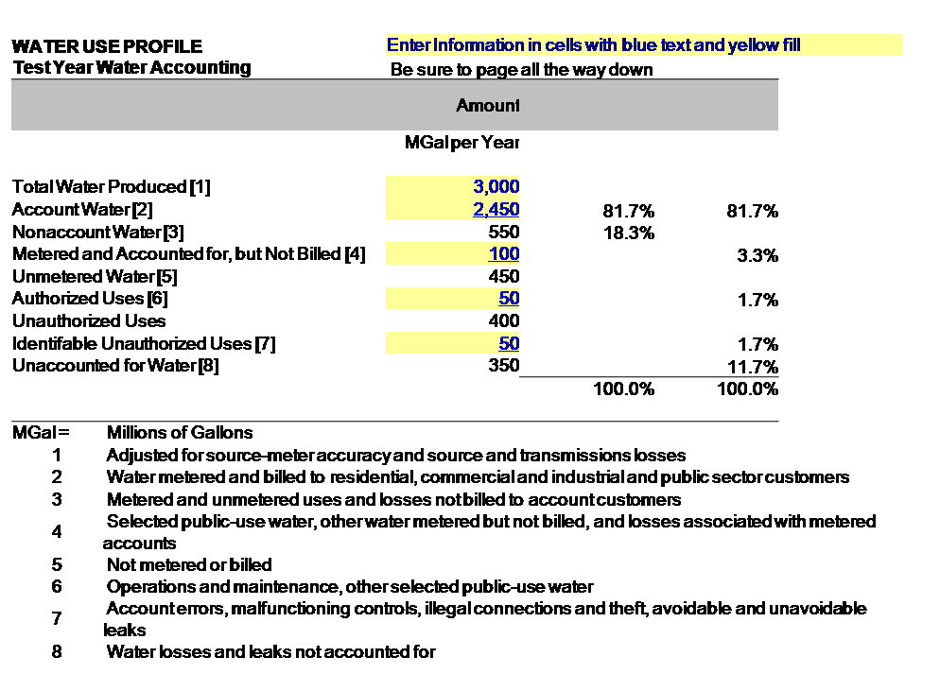
Cost Benefit Analysis of Water Conservation
 | Costs and Benefits
 |  | Baseline Account Water, MGal | 2,037.0
 |  | Account Water with Conservation, MGal | 1,437.6
 |  | Savings, MGal | 599.4
 |  | Upfront Conservation Measures Costs | $ 5,563,600
 |  | Ongoing Conservation Measures Costs | $ 500
 |  | Annualized Conservation Measures Costs | $ 446,938
 |  | Annual Savings | $ 306,583
 |  | Benefit / Cost | 0.69
 |  | Discount and bond rate | 5.0%
 |  | Loan Term | 20
 |  | Inflation Rate | 4.0%

Slide 10
Evaluation of Groundwater & Surface Water Interaction
$101,000
Complete
Partnered with Barr Engineering
Benefits: monitoring and management activities are better targeted to protect vulnerable lakes, wetlands, and streams

Slide 11
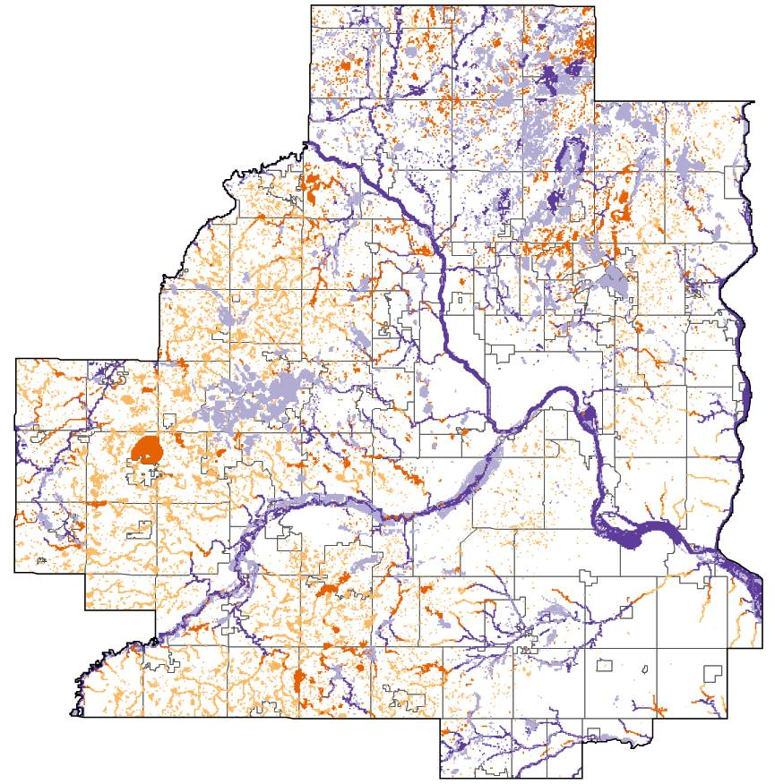
Evaluation of Groundwater & Surface Water Interaction
Over 100,000 surface
waters analyzed:
52% are disconnected from the regional groundwater system
30% recharge aquifers
16% receive and discharge groundwater
2% are supported by upwelling groundwater

Slide 12
Geologic Mapping & Groundwater Chemistry
$74,200
Complete
Partnered with Minnesota Geological Survey
Benefits: improved aquifer management and source water protection

Slide 13
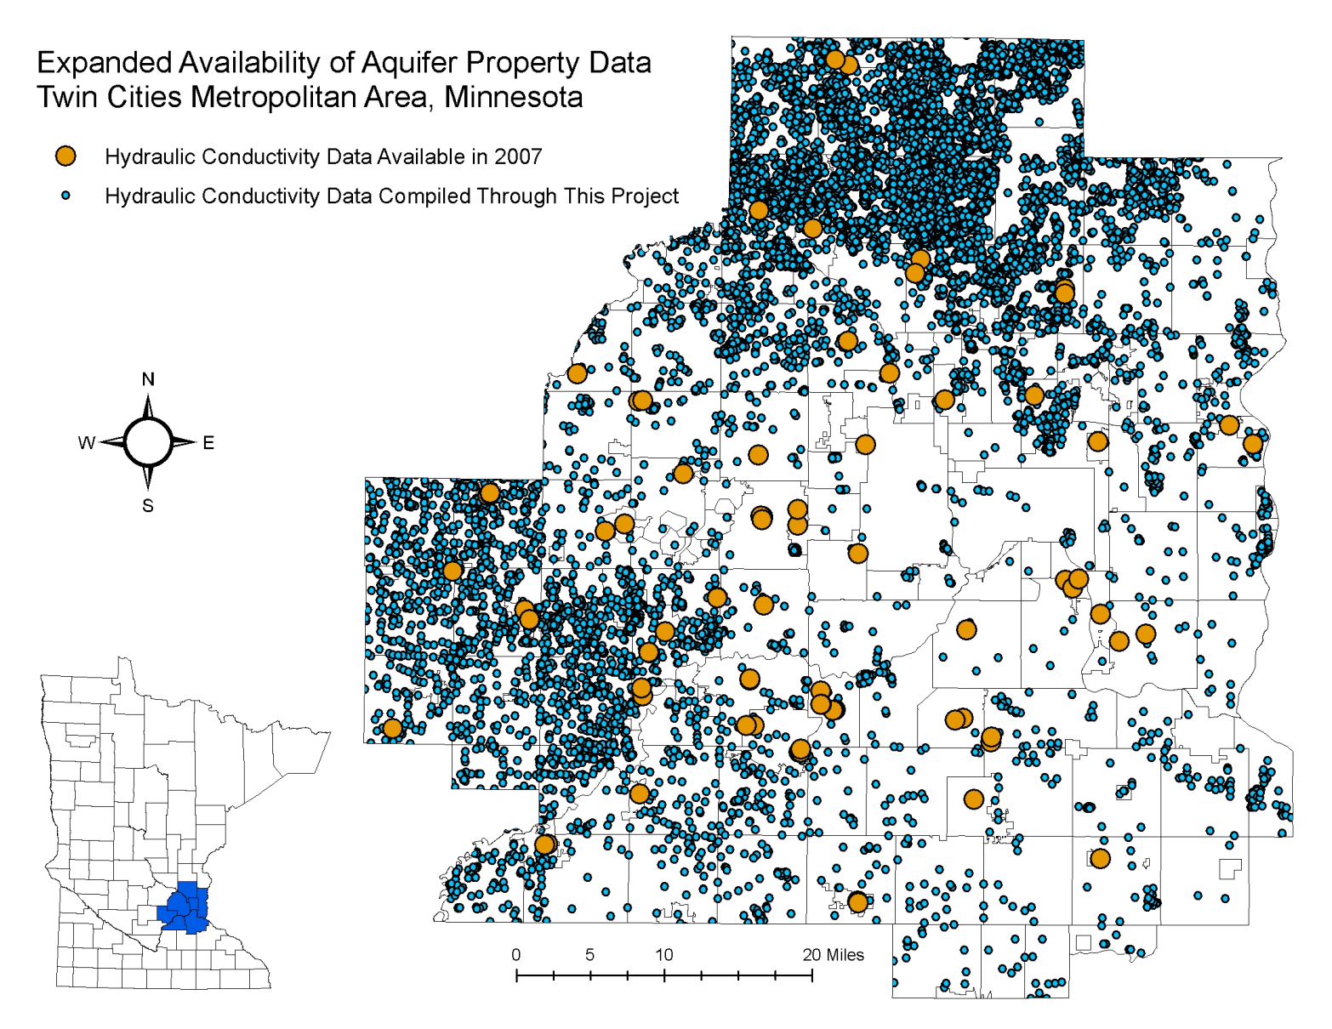
Geologic Mapping & Groundwater Chemistry

Slide 14
Stormwater Reuse Guidance
$103,000
In progress – due 9/30/11
Partnered with Camp Dresser and McKee
Benefits: increased planning capability for stormwater reuse
Required by 2011 Legislative appropriation

Slide 15
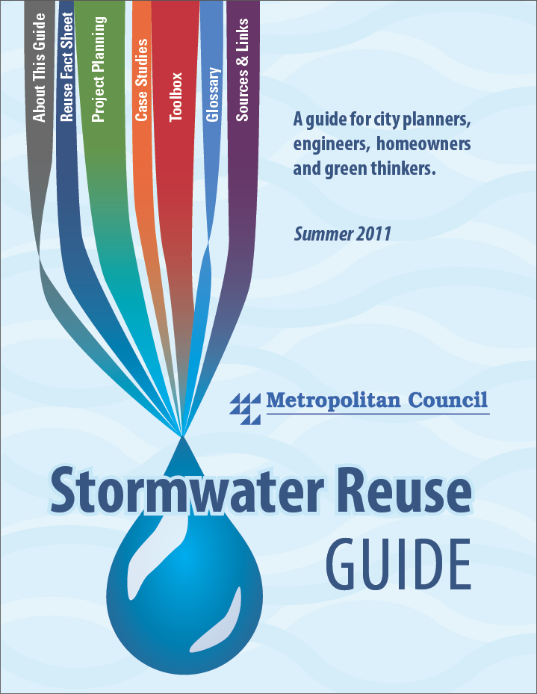
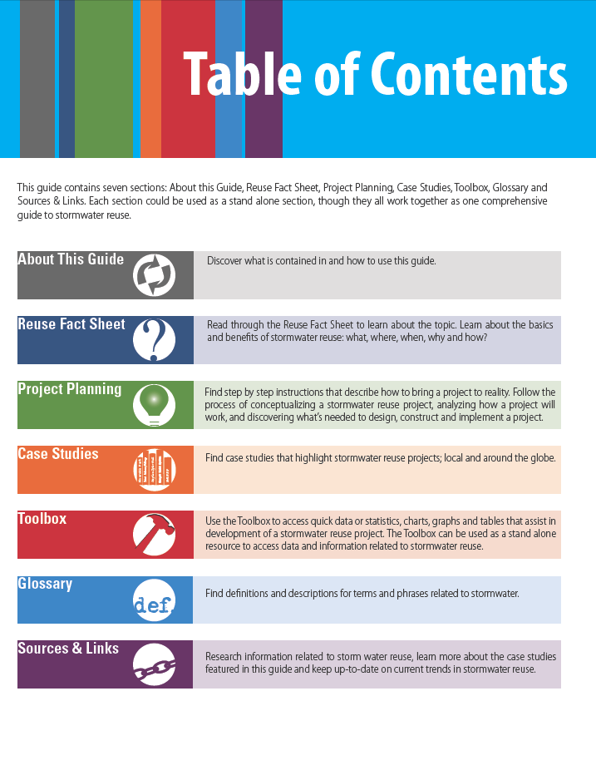
Stormwater Reuse Guidance

Slide 16
Mapping the Vulnerability of Glacial Aquifers/Plume Maps
$115,000
In progress – due 10/31/11
Partnered with Minnesota Geological Survey
Benefits: improved long-term planning for well locations and source water protection
Required by 2011 Legislative appropriation

Slide 17
Mapping the Vulnerability of Glacial Aquifers/Plume Maps
Glacial Aquifers
Bedrock Aquifers

Slide 18
Seminary Fen Protection
$90,000
In progress
Partnered with Chaska, Chanhassen, Carver County, Lower MN Watershed District, DNR
Benefits: improved land use and restoration planning to protect and enhance the fen
Required by 2011 Legislative appropriation

Slide 19
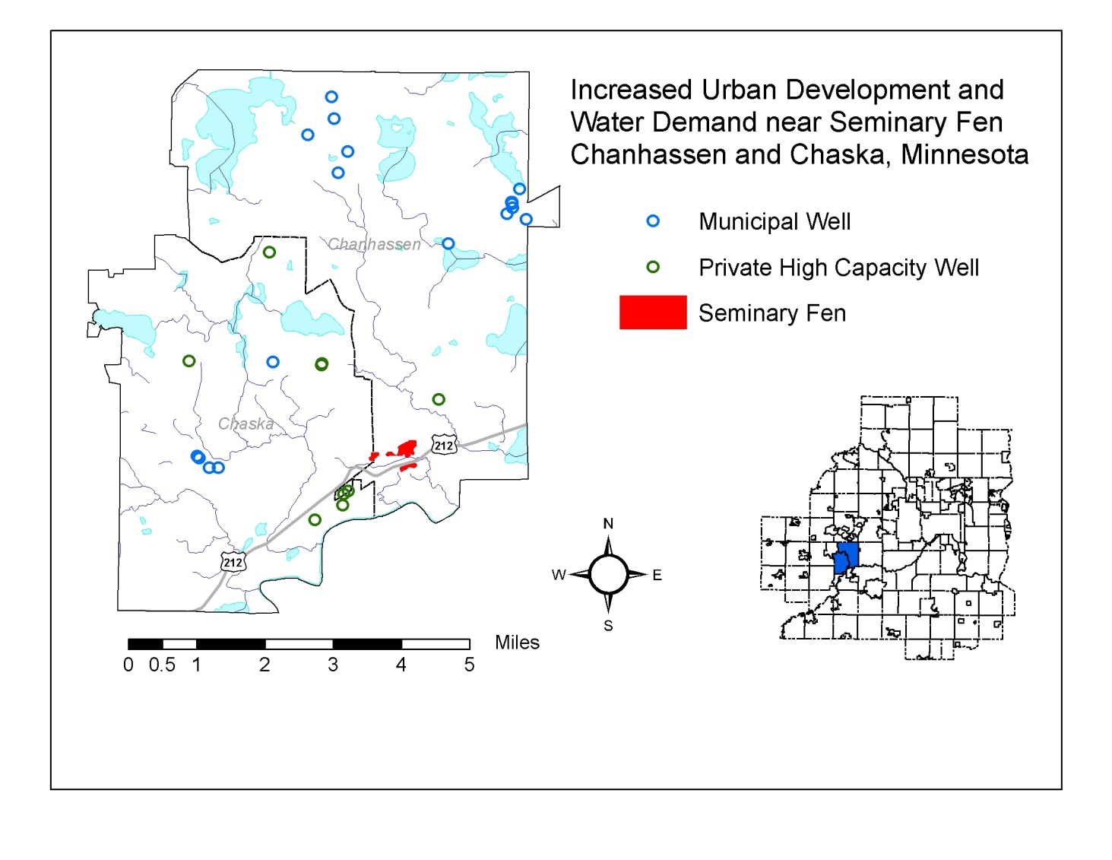
Seminary Fen Protection
Groundwater Flow

Slide 20
South Washington County Water Supply Plan
$92,000
In progress
Partnering with Cottage Grove, Woodbury, Washington County, watershed districts, state agencies
Benefits: improved planning to ensure high quality water is available while protecting natural resources
Required by 2011 Legislative appropriation

Slide 21
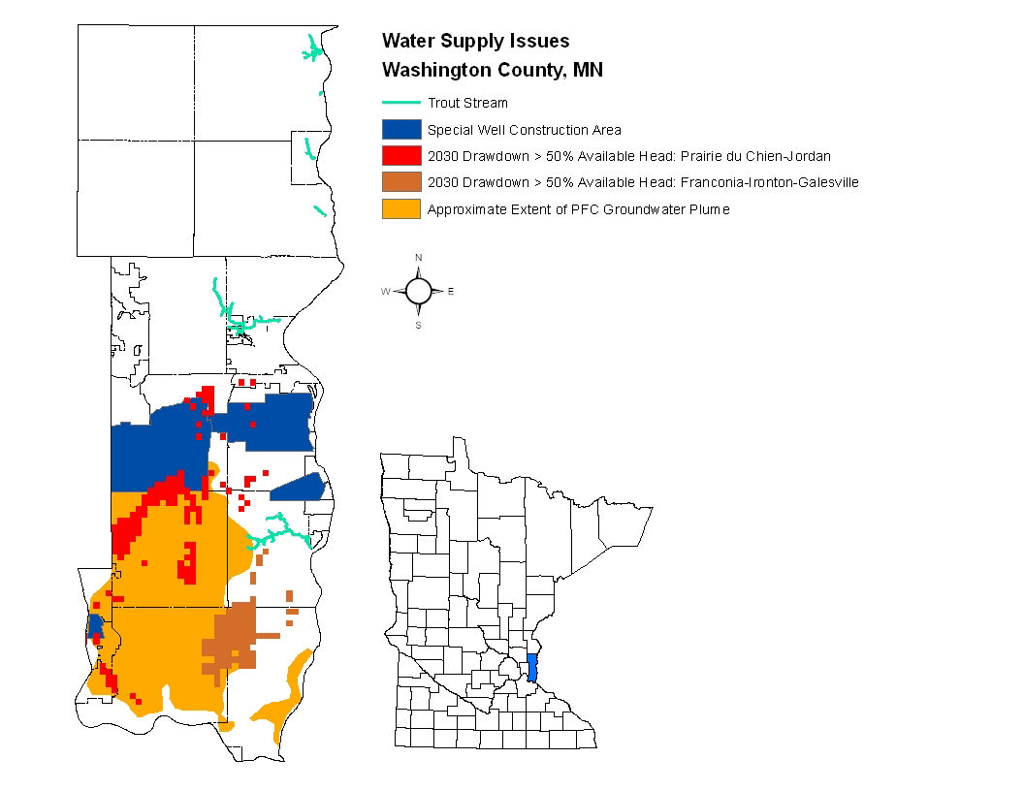
South Washington County Water Supply Plan

Slide 22
Rural Capacity for Source Water Protection
$50,000 (estimated)
In development
Partners to be determined
Benefits: improved source water protection methods in rural areas
Deliverables: benchmark data, summary report

Slide 23
Regional Recharge Model Update
$100,000 (estimated)
In development
Partners to be determined
Benefits: improved capability to predict recharge under different land use and climate scenarios
Deliverables: recharge model, maps, report

Slide 24
Regional Groundwater Flow Model Update
$250,000 (estimated)
In development
Partners to be determined
Benefits: improved capability to accurately predict conditions, including seasonal effects
Deliverables: groundwater flow model, maps, report

Slide 25
Improving Industrial Water Efficiency
$100,000 (estimated)
In development
Partners will include high demand industries
Benefits: improved efficiency will decrease metro demand and business costs
Deliverables: industrial water efficiency benchmarks, audits for selected partners

Slide 26
Evaluation of Stormwater Infiltration BMPs
$100,000 (estimated)
In development
Partners will include watershed districts
Benefits: improved use of stormwater BMPs to protect and enhance groundwater
Deliverables: report, BMP siting guidance

Slide 27
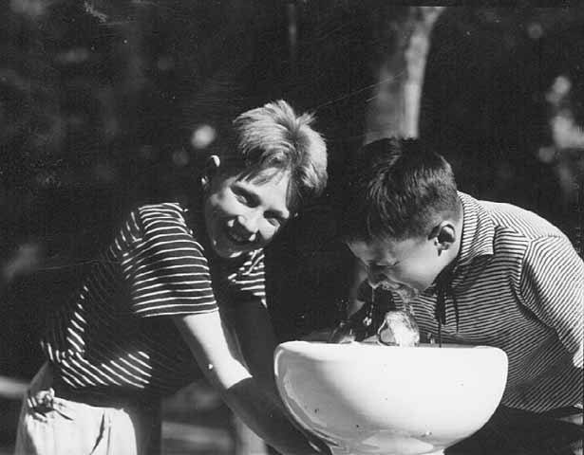
Thank you!

