Slide 1
Metropolitan Council
Metropolitan Council
Environmental Services
Environmental Services
Capital Program Overview
Presented to
The Environment Committee
April 26, 2011
Bryce Pickart
Assistant General Manager
A Clean Water Agency

Slide 2
Outline of Presentation
Policy
Program
Projects
Process

Slide 3
Policy

Slide 4
Regional Development Framework
Regional Policies and Forecasts
Policy Plans/
System Plans
Wastewater Policies Long-Term Plans
System Statements
to Communities
Forecasts for Sewered Development
Local Comprehensive
Sewer Plans
Staging Plans Connection Points
Commitment
to Serve
Council Approval
Implementation
Capital Projects
as needed

Slide 5
Wastewater Policies
Key Overall Policy:
Support orderly and economical development of the Region.
Supporting Policies:
Preserve and utilize infrastructure efficiently.
Expand capacity as needed and planned.
Work with customer communities to reduce infiltration and inflow.

Slide 6
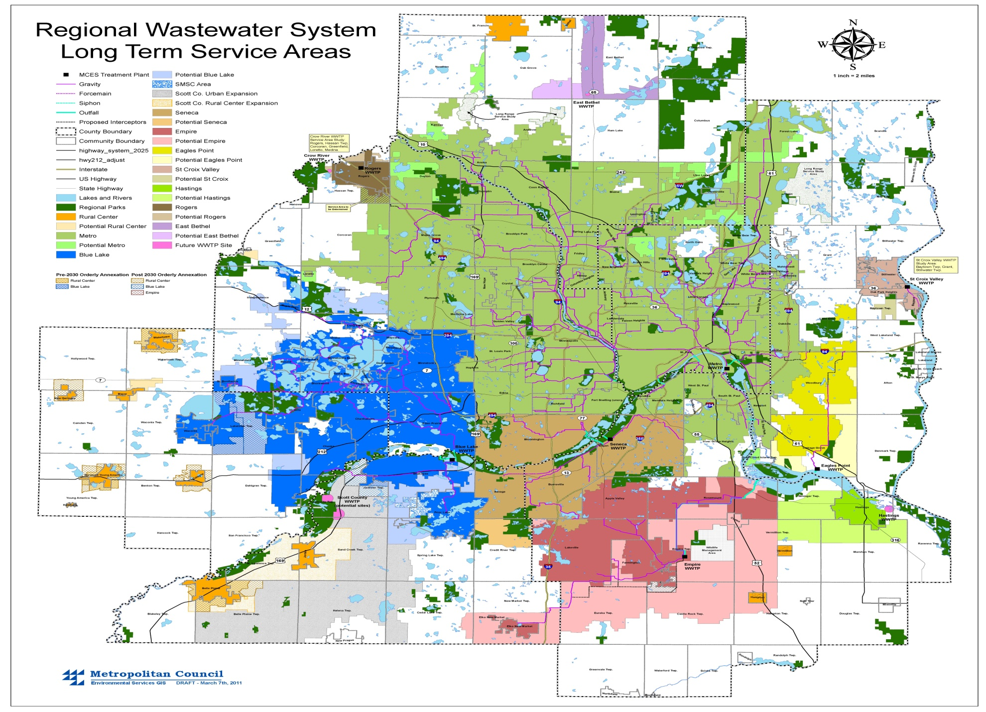

Slide 7
Program

Slide 8
Capital Program Strategy
Maintain infrastructure ($4 Billion Asset)
Meet our commitments
Moderate rate impacts
Prepare for the future

Slide 9
Condition Assessment
Capacity Analysis
Capital
Project Initiation
Process
Improvement
Regulatory Requirements
Wastewater System Evaluation

Slide 10
High Priority Capital Projects
Rehabilitation/Replacement
High risk of delay based on condition assessment, failure mode, probability of failure occurrences, and severity of failure (public health, water quality, permit compliance, other impacts).
Opportunity to coordinate with other infrastructure projects.

Slide 11
High Priority Capital Projects (cont.)
Quality Improvement
Regulatory commitments
Efficiency, effectiveness, and reliability improvements, such as energy conservation and dual forcemains.
Growth
Support redevelopment
Meet customer service commitments

Slide 12
Projects

Slide 13
Key Projects - Plants
Blue Lake Plant
Rehabilitation
Solids Processing/Energy
Metropolitan Plant
Solids Processing
Rehabilitation
East Bethel Plant
Water Reclamation Facility

Slide 14
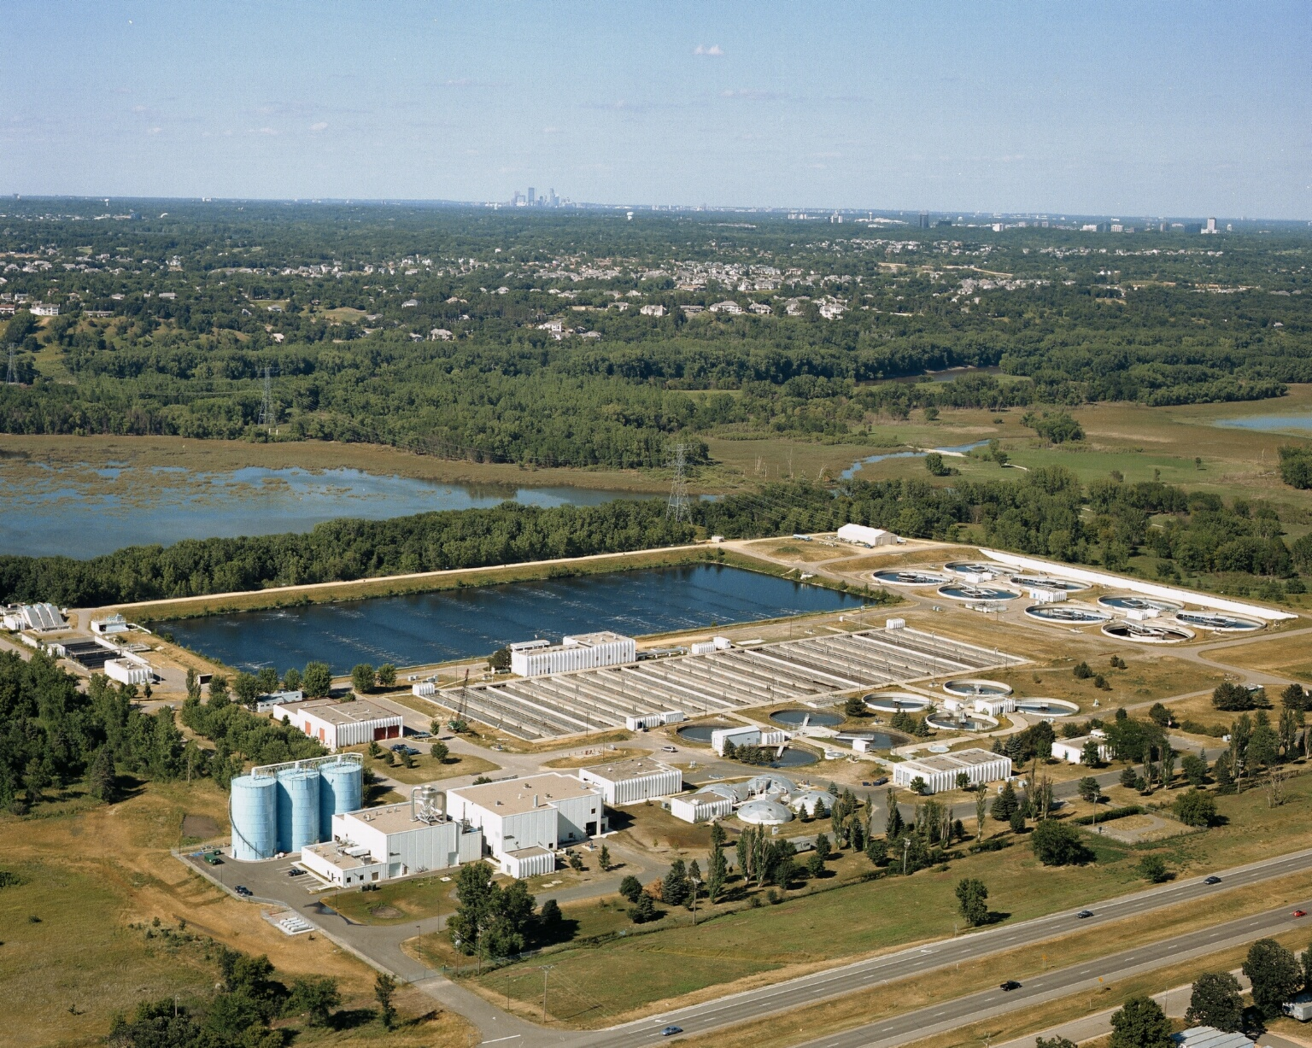

Slide 15
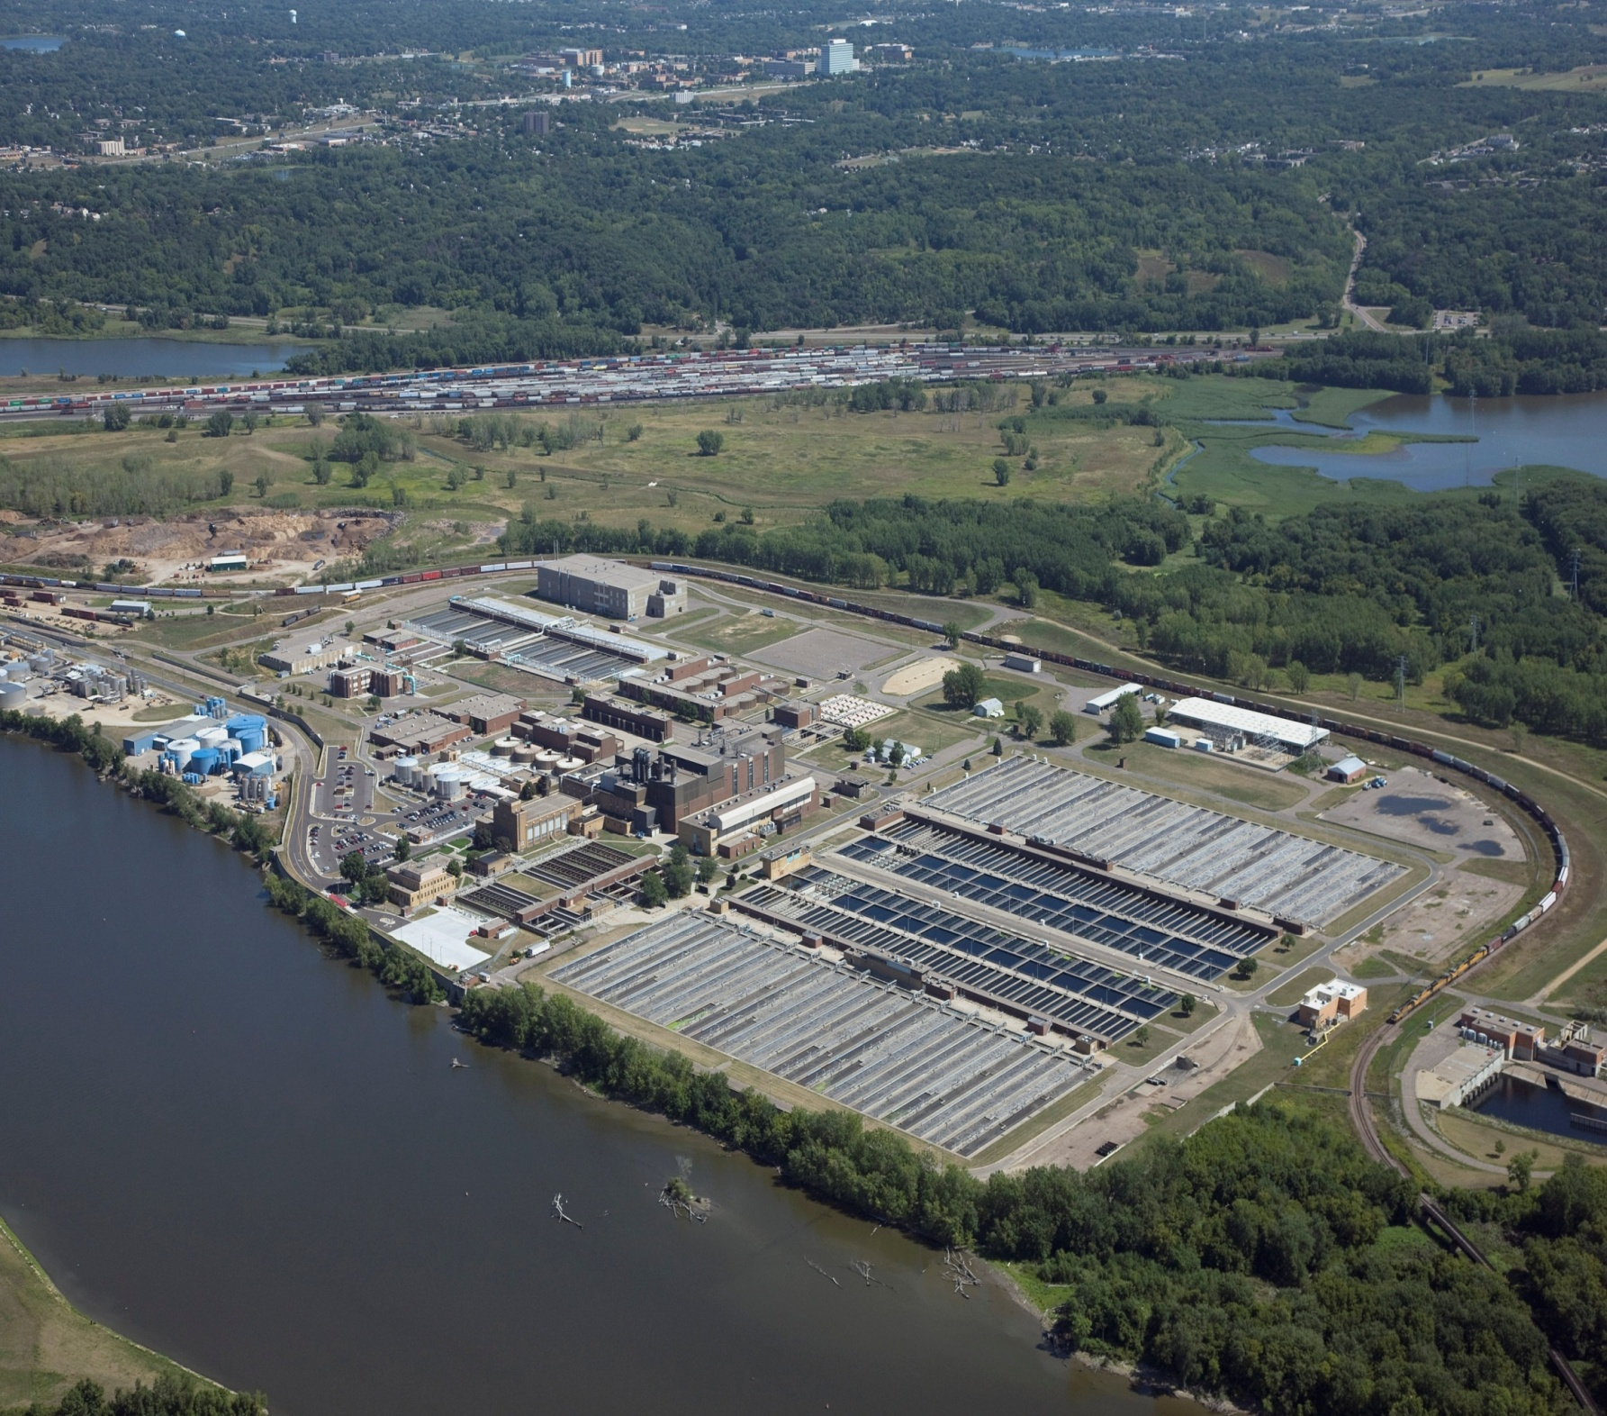

Slide 16
Key Projects - Interceptors
Rehabilitation Projects
South St. Paul Forcemain
Hopkins Lift Station and Forcemain
Minneapolis Interceptors
Lake Minnetonka Area
Meters
Shakopee Interceptor
Plymouth Forcemain

Slide 17
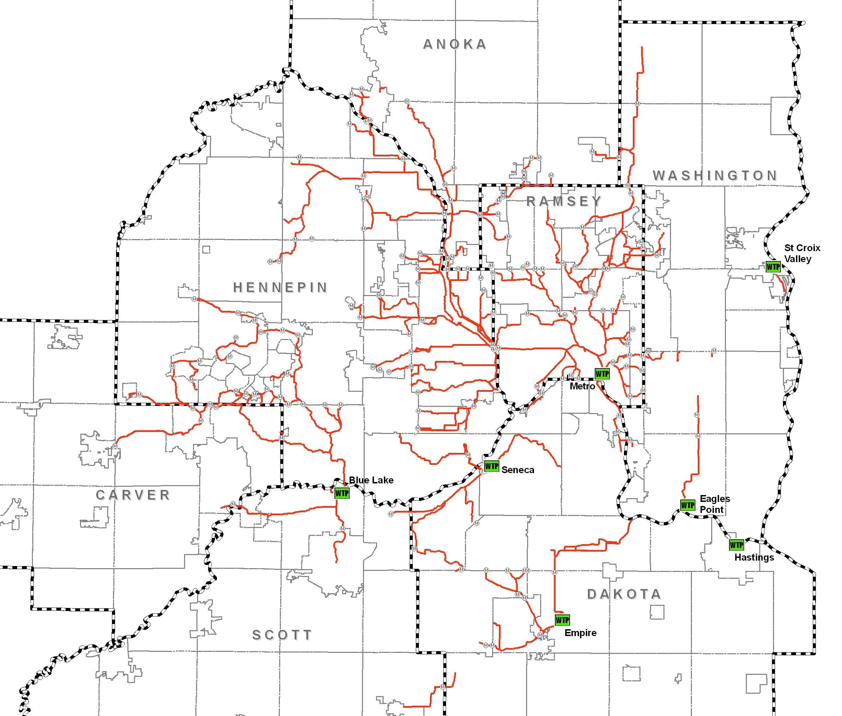
Plymouth Forcemain
Lake Minnetonka Area
Hopkins Lift Station & Forcemain
Minneapolis Interceptors
So. St Paul
Forcemain
Shakopee Interceptor

Slide 18
Key Projects - Interceptors
Capacity/Growth Projects
Richfield/Edina/Bloomington
Golden Valley/St. Louis Park
Carver
Elko-New Market

Slide 19
Golden Valley St Louis Park
Richfield/Edina/Bloomington
Carver Interceptor
Elko-New Market

Slide 20
Process

Slide 21
Definitions
Capital Improvement Program (CIP)
6-Year Plan
Authorized Capital Program
Multi-Year Authorization
Capital Budget
Annual Appropriation

Slide 22
Capital Improvement Program
Expenditures by Year ($ millions)
2011-2016 Total = $579 Million

Slide 23
Capital Improvement Program
Cost Breakdown by Project Objective
Preserve
62%
Improve 6%
Expand
32%
Total Program
2011 - 2016
$579 Million

Slide 24
Capital Improvement Program
Uses by Category
Interceptors
61%
Rural Areas 5%
Treatment Plants
34%
Total Program
2011 - 2016
$579 Million

Slide 25
Annual Council Approvals
Capital Improvement Program (CIP)
Adopts the MCES 6-Year CIP as part of the Metropolitan Council Unified CIP
Authorized Capital Program
Authorizes the projects/programs, their budget, and phase (Preliminary Engineering, Design, or Construction)
Capital Budget
Authorizes the anticipated cash flows of the projects/programs for the year

Slide 26
Project Authorization Phases
Preliminary Engineering Phase
This phase is initially authorized in the Capital Program to develop a plan to address an identified need.
Design Phase
Authorized by the Metropolitan Council following their approval of the project’s Facility Plan or preliminary engineering study. Depending upon the project, the authorization at this stage may include both the project’s design and construction phases including their funding.
Construction Phase
If not already provided, authorization and funding is provided for the construction phase by the Metropolitan Council following the preparation of the project’s design (plans and specifications).

Slide 27
Other Capital Project Council Actions
Professional Services Contracts
Awards contracts (>$250,000)
Preliminary Engineering Phase
Approves Facility Plans and/or Preliminary Engineering Reports
Construction Phase
Awards construction contracts (>$1 M)
Authorizes increase in the 5% delegated change order authority, if needed

Slide 28
Capital Project Controls
Capital Project Delivery Analysis
Design Guidelines
Quality Assurance
Work Instructions

Slide 29
Capital Project Delivery
Design-Bid-Build
Plans, Specifications, and Contract Documents
Prequalification of Construction Contractors and Sub-contractors for Critical Work
Sealed Competitive Bids
Best Value Construction Procurement Option
Design-Build
Proposal Evaluation
Criteria for Use
Inter-Governmental Agreements

