Slide 1

Metropolitan Council
Environmental Services
Info Item:
MCES Flood Update
Presented to the Environment Committee
March 22, 2011
Leisa Thompson, Deputy General Manager, Treatment Services
A Clean Water Agency

Slide 2
Presentation Outline
MCES Treatment Plant Locations, Service Areas
Flood Briefing/Forecast
Metro Plant Preparation Activities
Metro Plant Past Flood Views
Regional Plants Forecast, Preparation

Slide 3
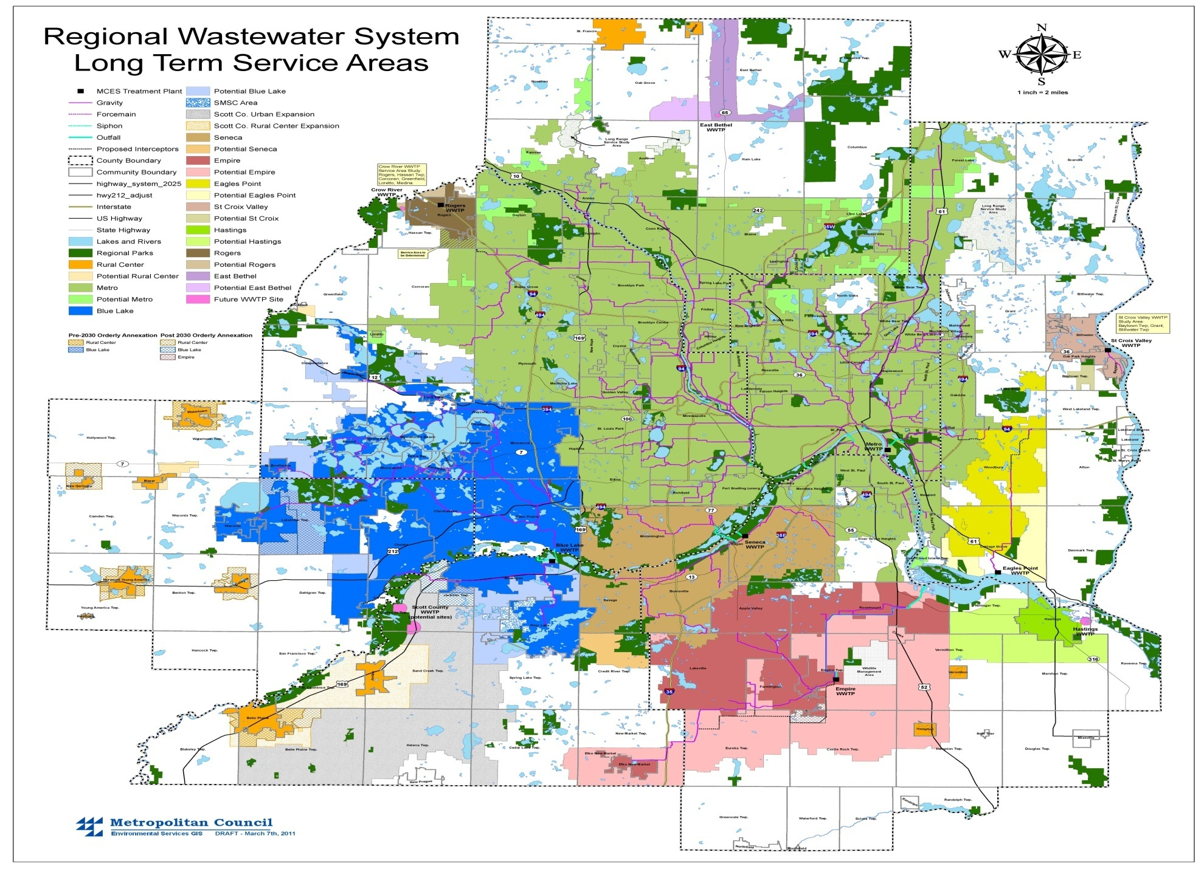

Slide 4


Slide 5
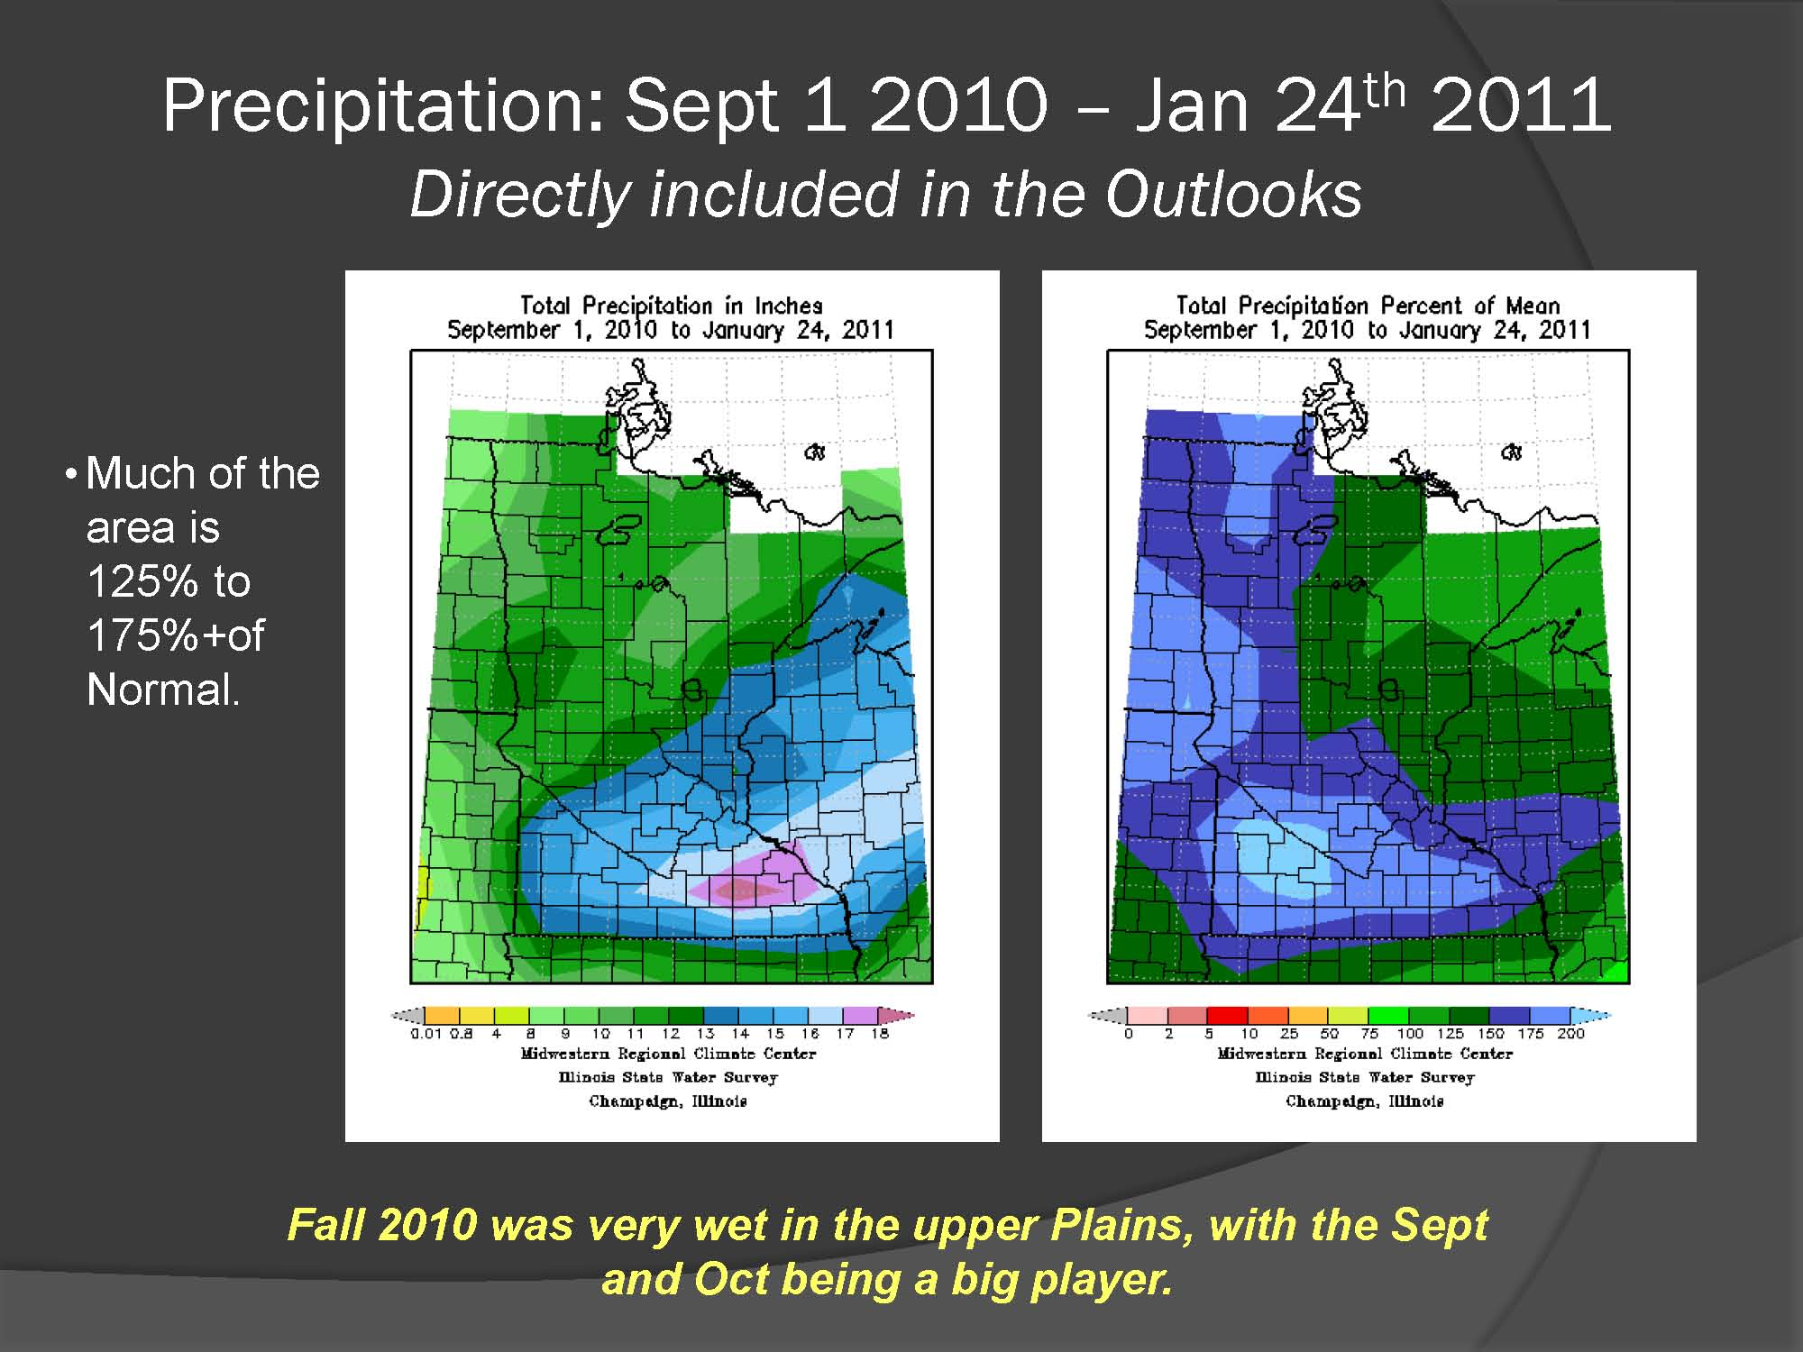

Slide 6
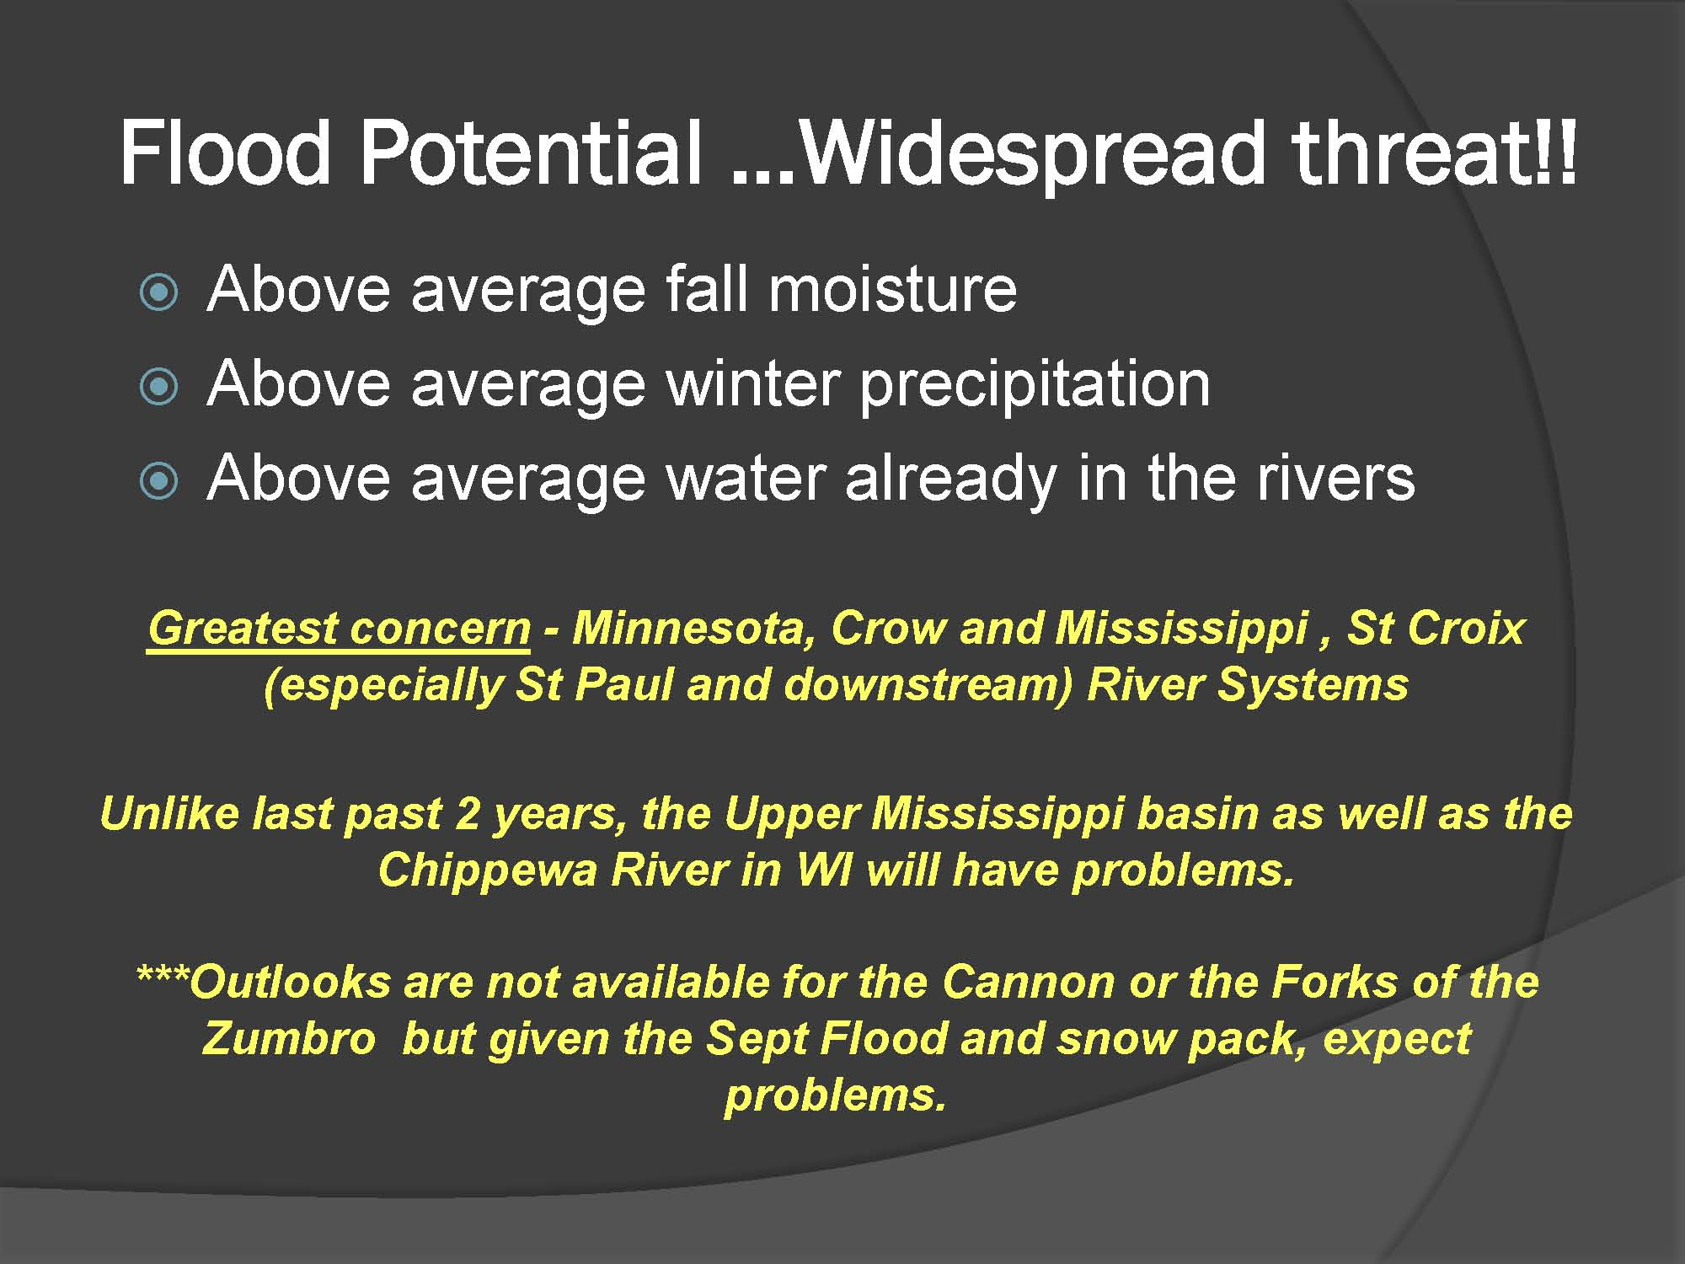

Slide 7
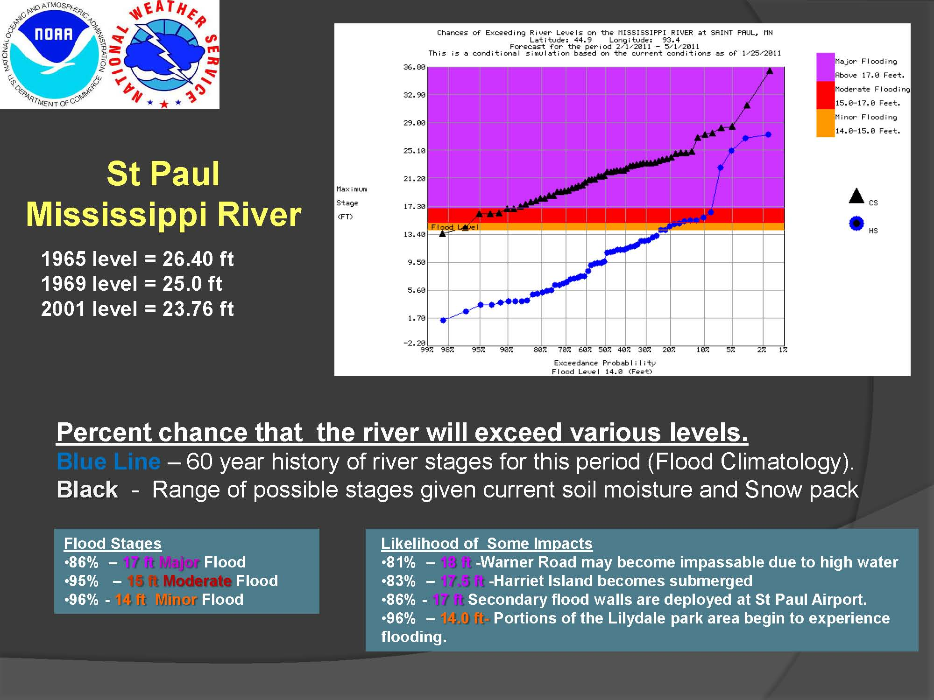

Slide 8
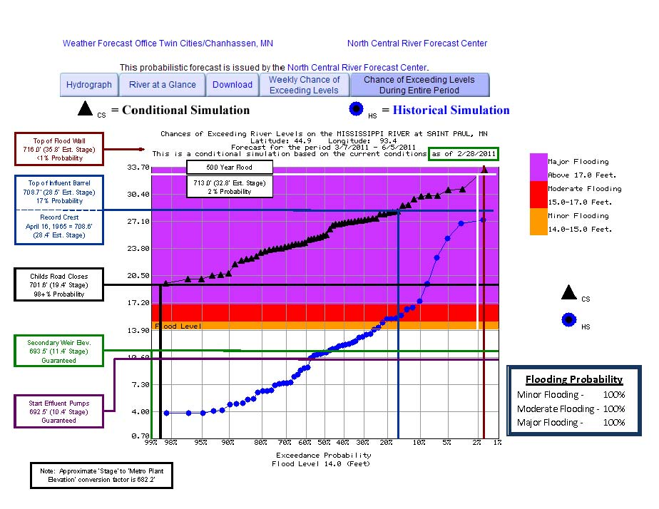

Slide 9
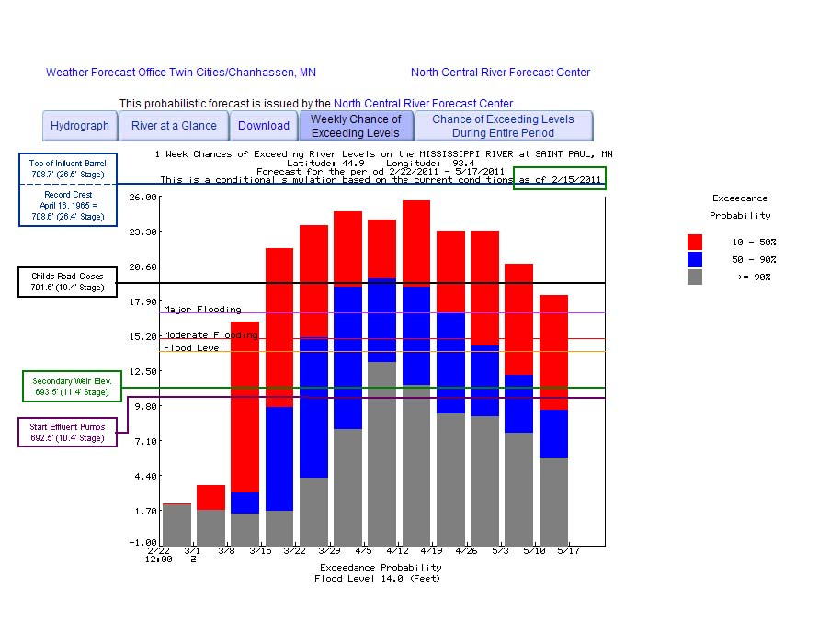

Slide 10
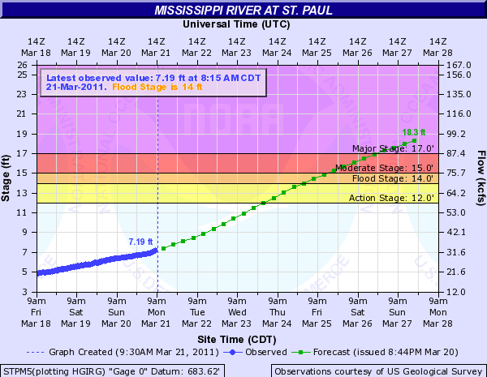

Slide 11
Metro Plant Flood Preparations
Use emergency generators
Build Childs Road ramp (if needed)
Use sand bags, stop logs
Hold meetings with neighboring businesses
Coordinate with City/County Emergency Offices
Increase Critical Process Chemicals Inventory
Provide 24/7 electrician and manager coverage

Slide 12
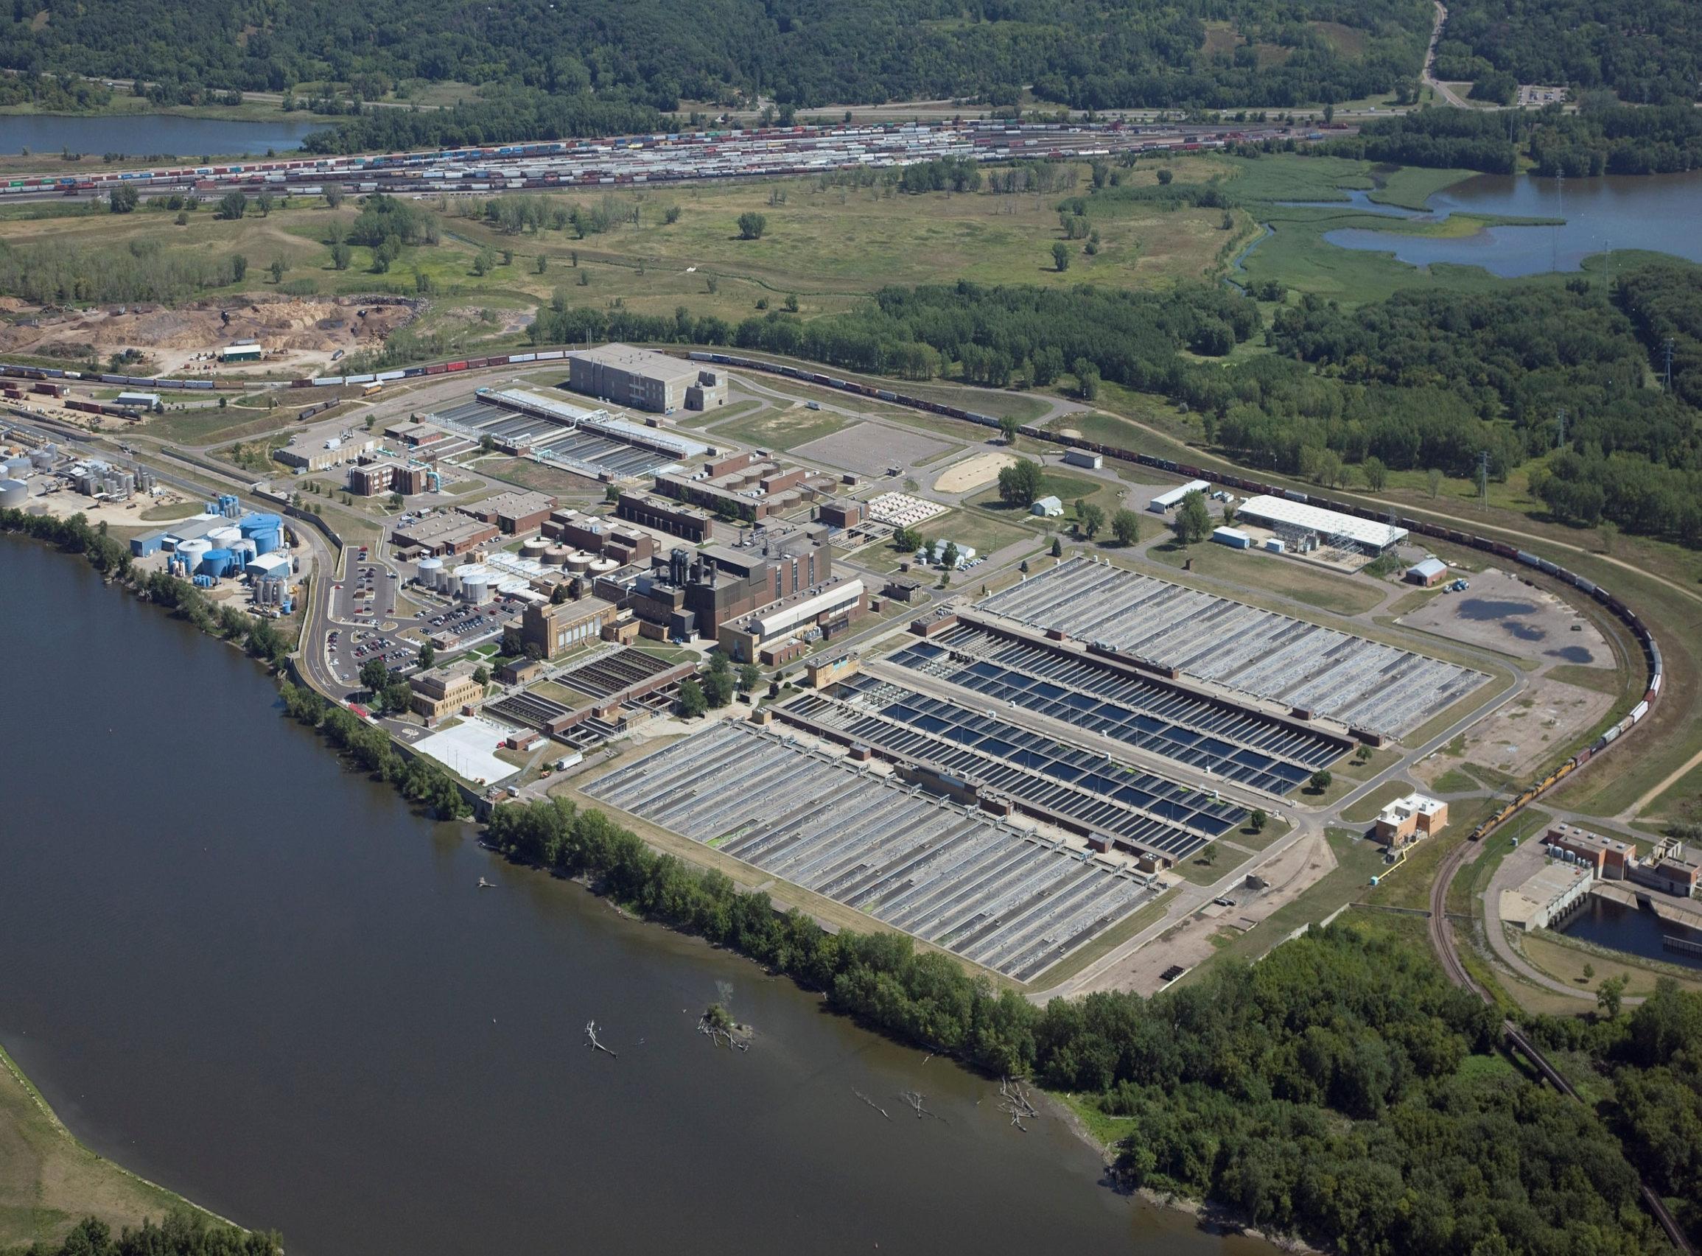

Slide 13
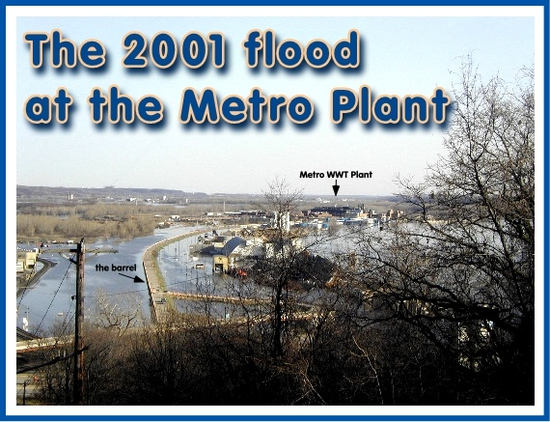

Slide 14
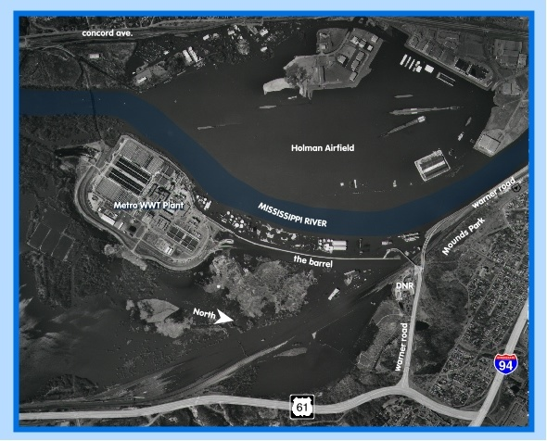

Slide 15
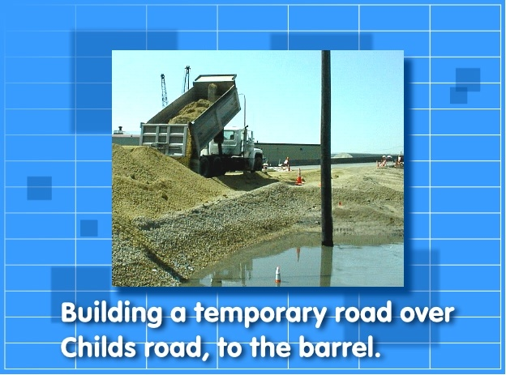
Building a temporary road over Childs Road, to the barrel

Slide 17
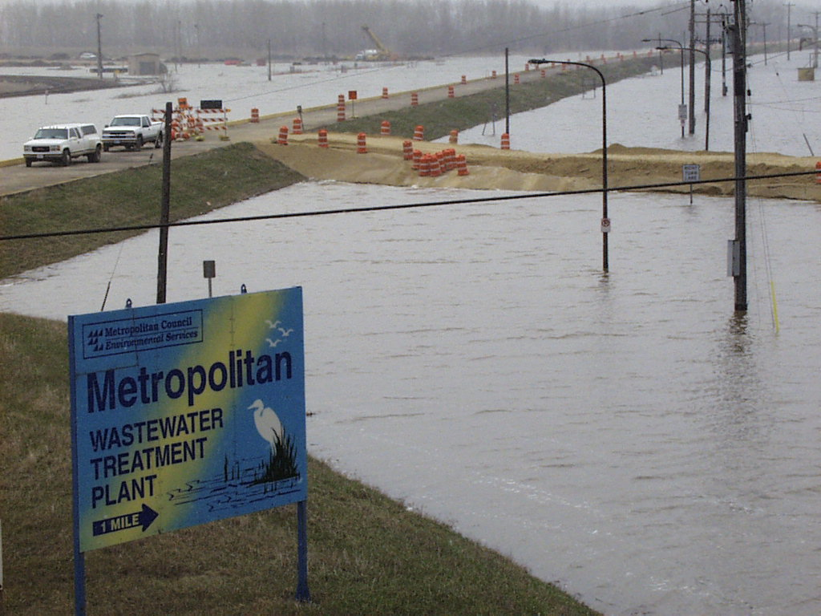

Slide 18
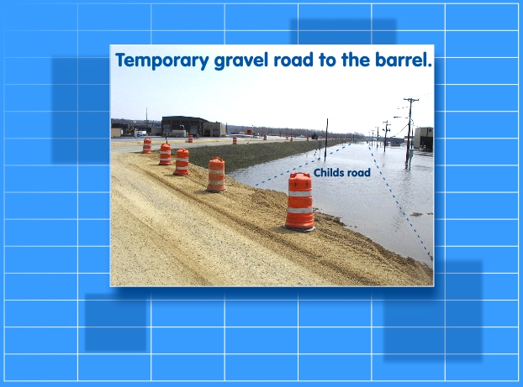
Temporary gravel road to the barrel

Slide 19


Slide 20
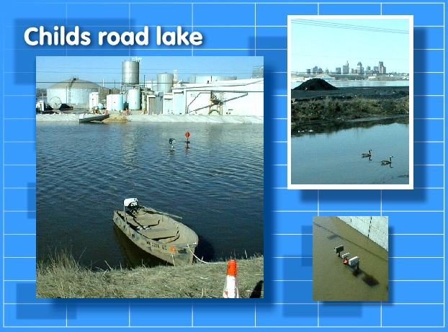
Flooded Childs Road

Slide 21

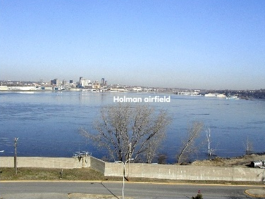
Metro Plant Flood Wall

Slide 22
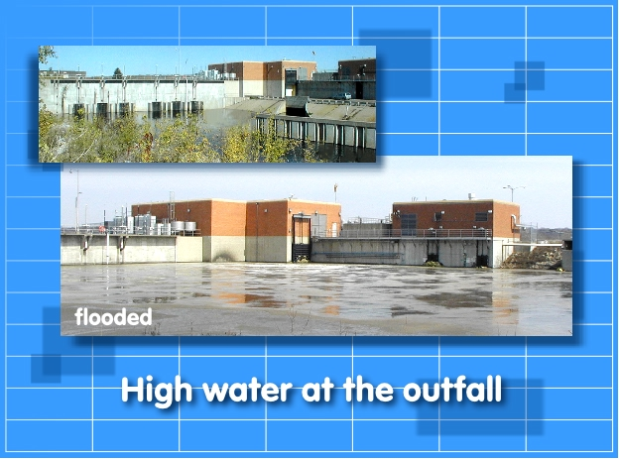
High water at the Outfall

Slide 23
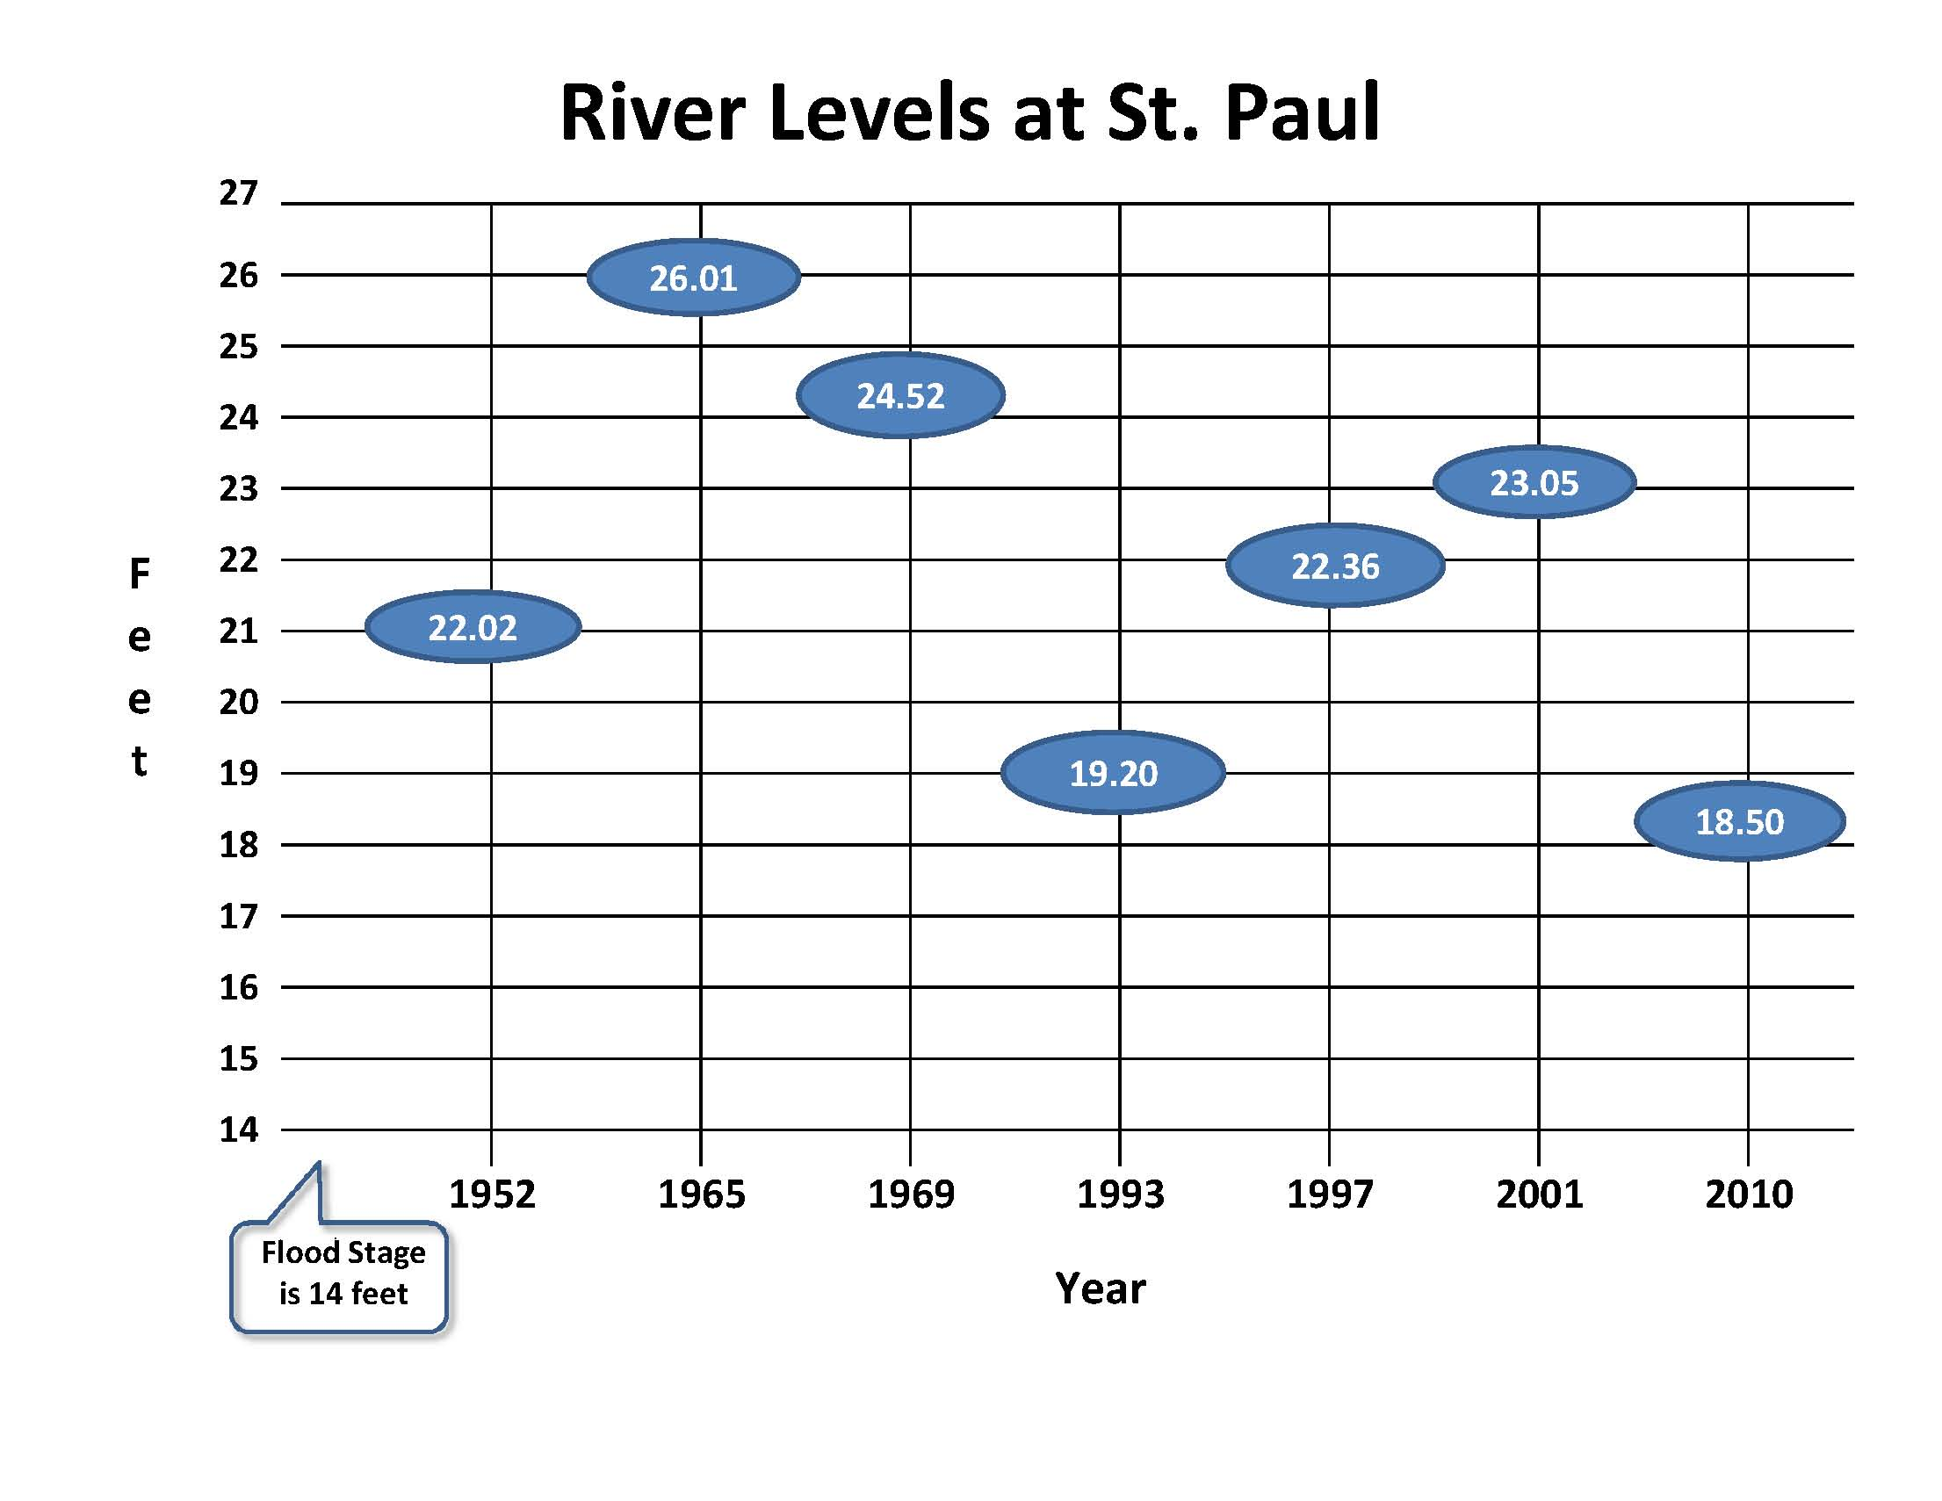


Slide 24
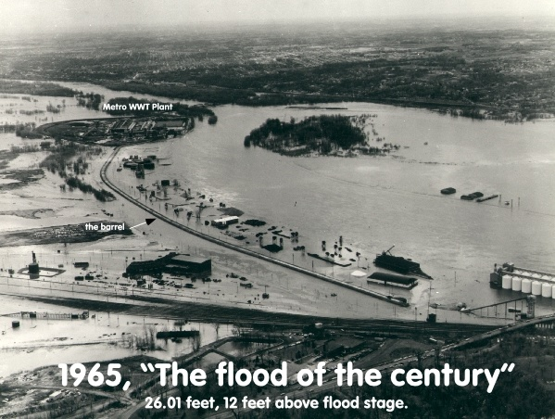

Slide 25
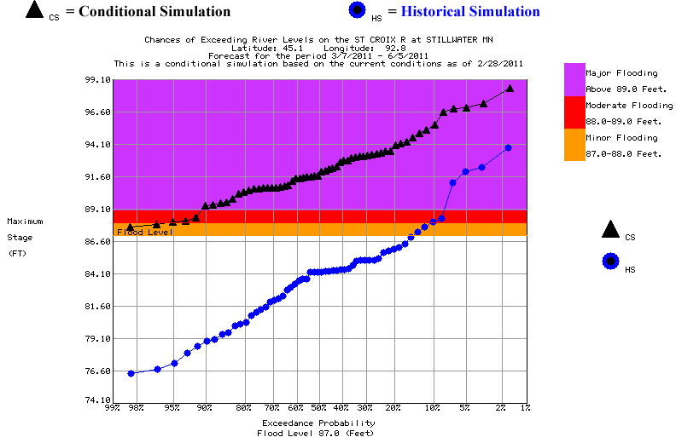
24/7 Staffing
695.0’
(95.0 ‘ Stage)
20% Probability
2001 Flood
692.5’
Night Time Inspections
690.0’
(90.0 ‘ Stage)
80% Probability
St. Croix River
At Stillwater
St. Croix Valley
Wastewater
Treatment Plant

Slide 26
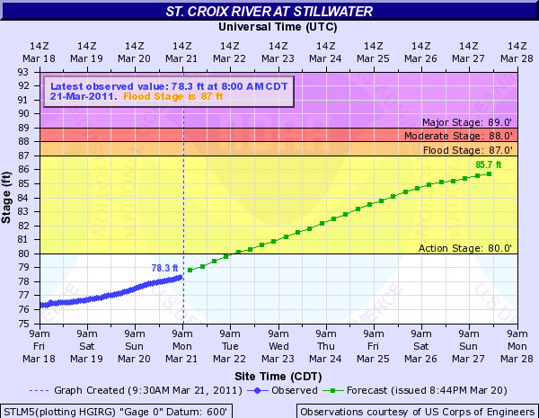

Slide 27
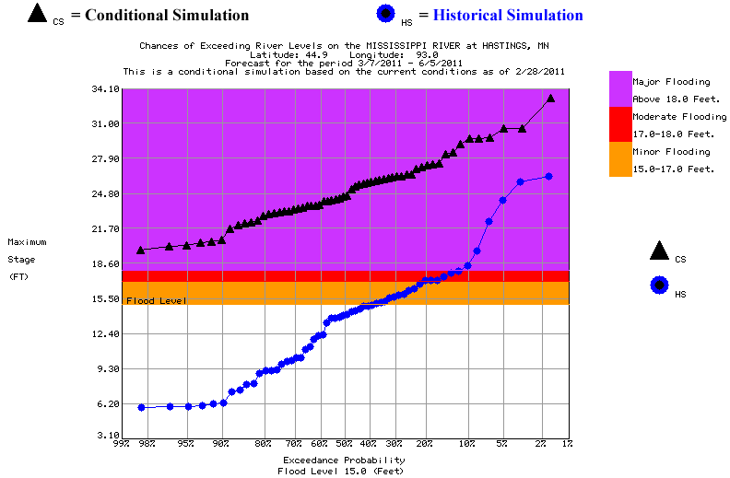
Top of Levee
Add Sand Bags
695.0’
(25‘ Stage)
50% Probability
2001 Flood
692.5’
24/7 Staffing
690.0’
(20.0 ‘ Stage)
90% Probability
Fill Empty Tanks
687.0’
(17.0 ‘ Stage)
100% Probability
Mississippi River
At Hastings
Hastings Wastewater
Treatment Plant

Slide 28
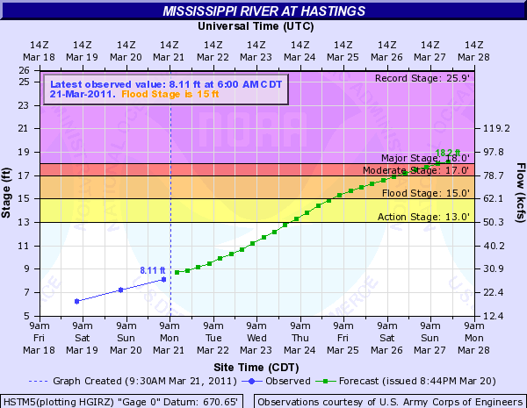

Slide 29
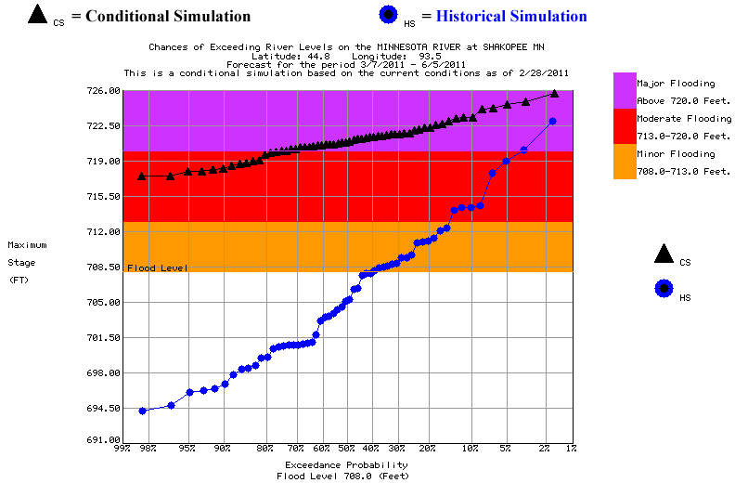
Top of Levee
Add Sand Bags
723.5’
10%
Probability
2001 Flood
719.0’
Start Screw Pumps
710.5’
100% Probability
Fill Empty Tanks
702.0’
100% Probability
Minnesota River
At Shakopee
Blue Lake Wastewater
Treatment Plant

Slide 30
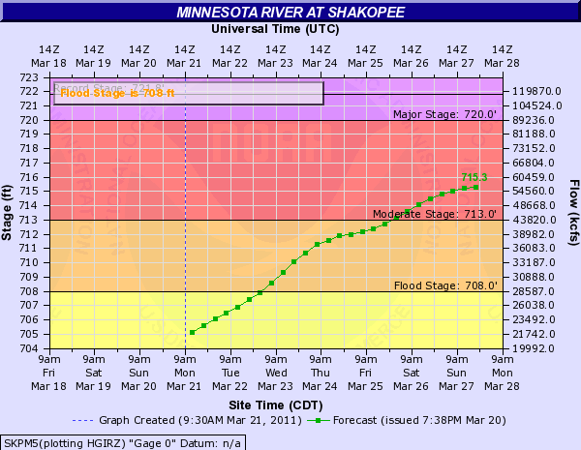

Slide 31

Questions or Comments?
Leisa Thompson, Deputy General Manager
Thank you!

