Slide 1

Metropolitan Council Environmental Services
2011 Flood Planning
February 8, 2011
Mike Mereness, Metro Plant Director
A Clean Water Agency

Slide 2
Presentation Outline
Flood Forecast
Metro Plant Preparation Activities
Metro Past Flood Views
Regional Plants Forecast and Preparation

Slide 3


Slide 4
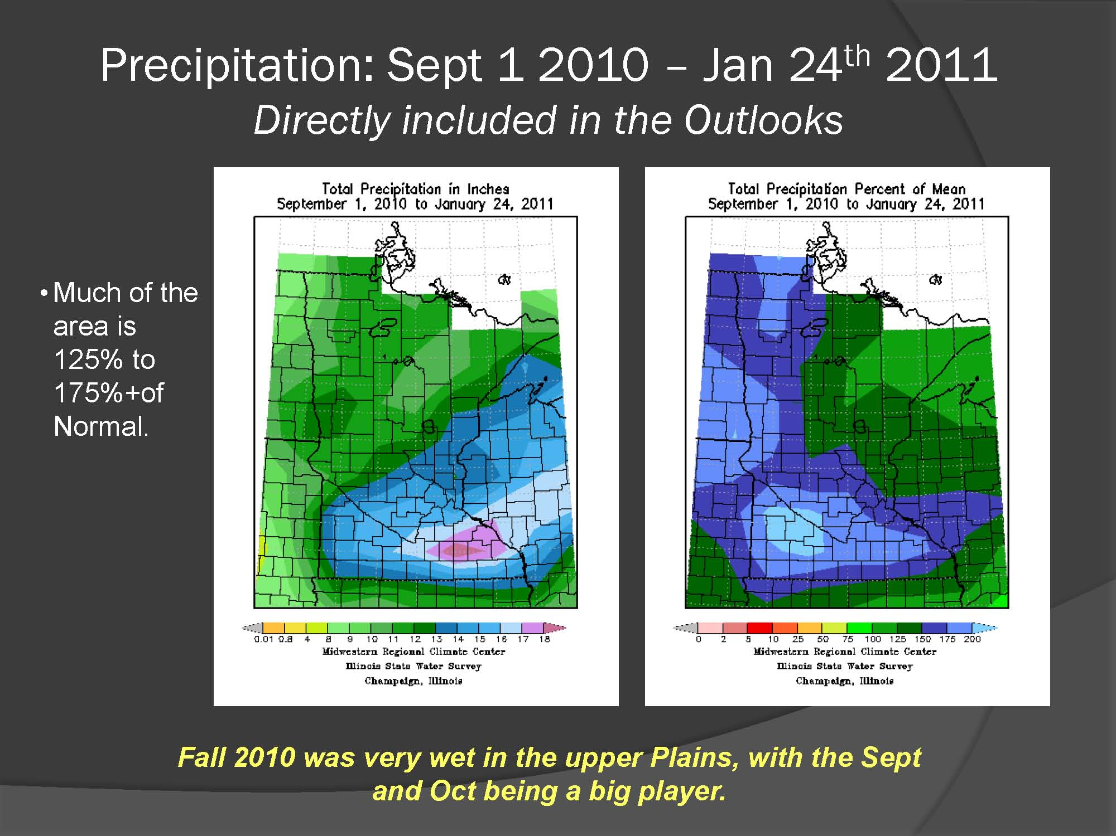

Slide 5
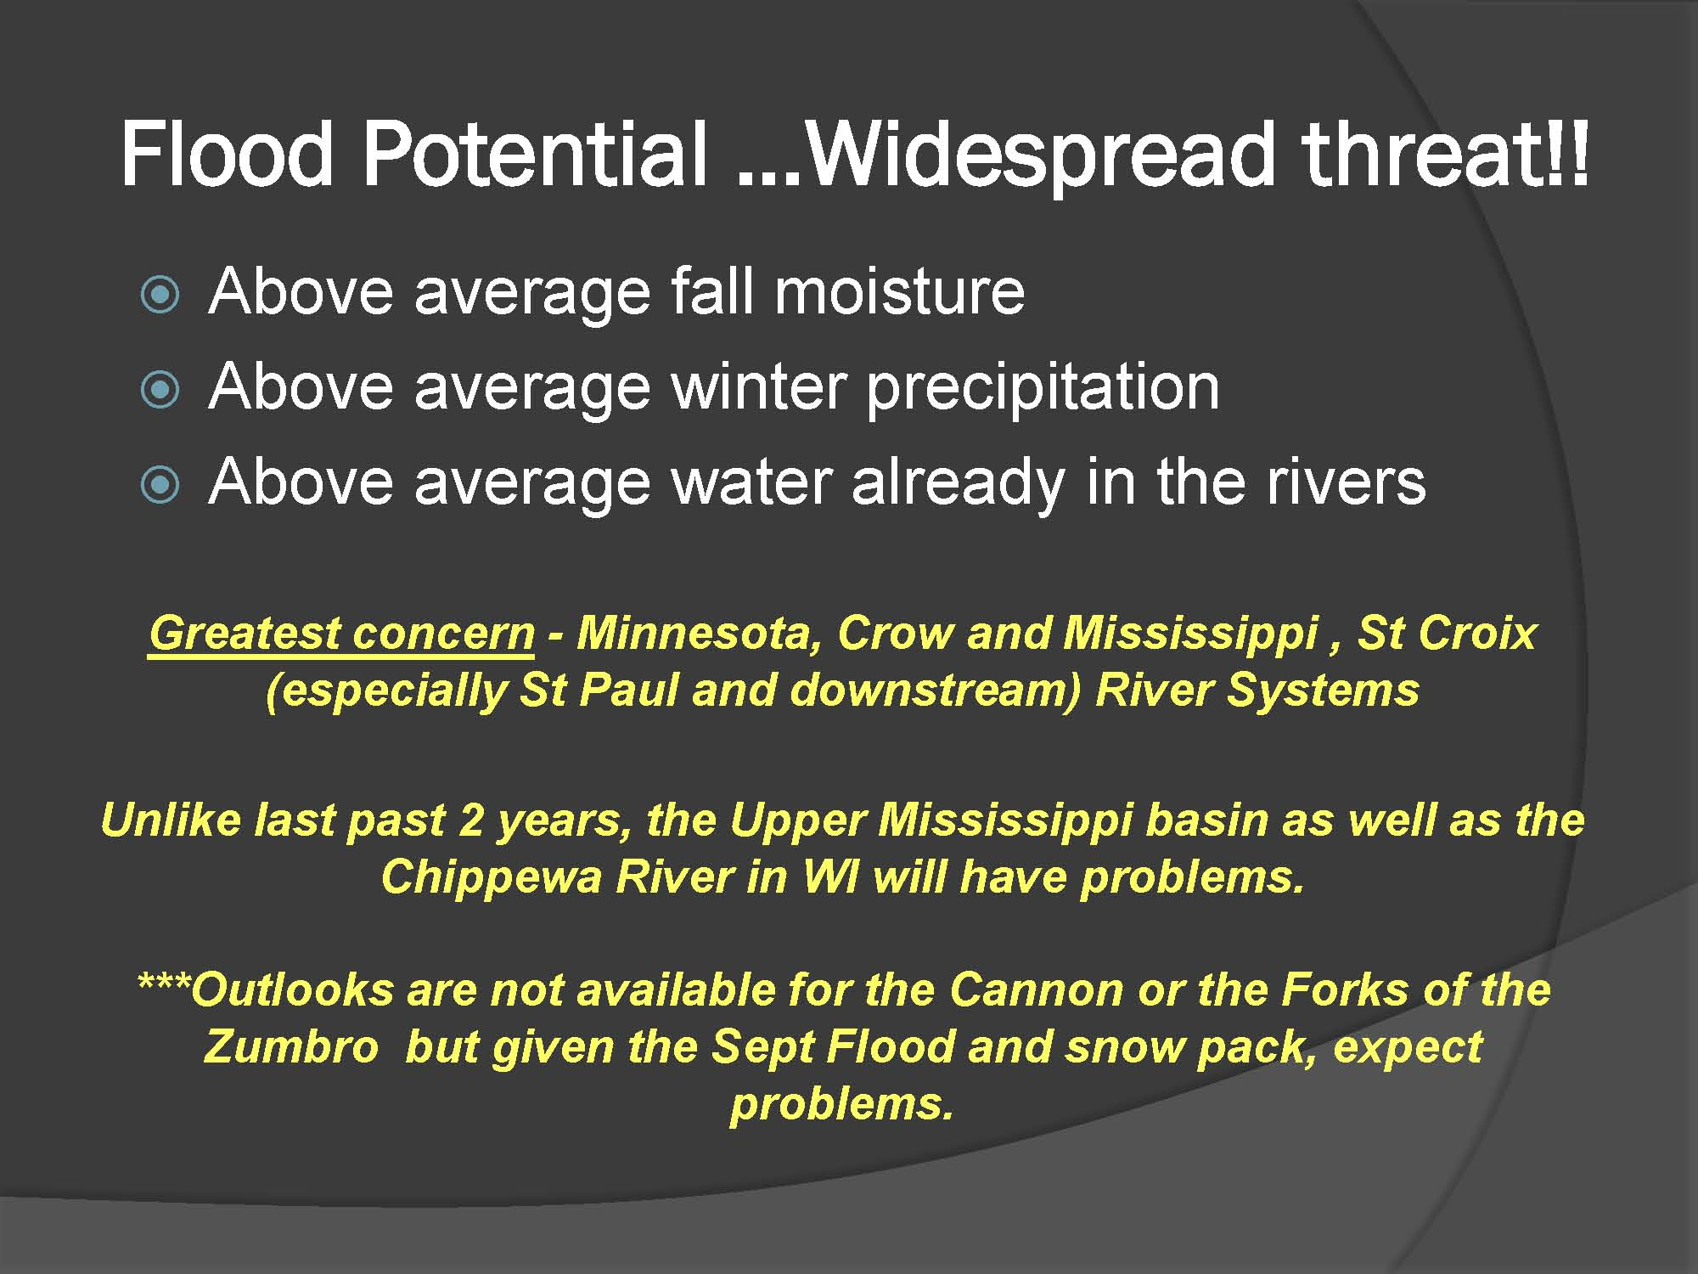

Slide 6
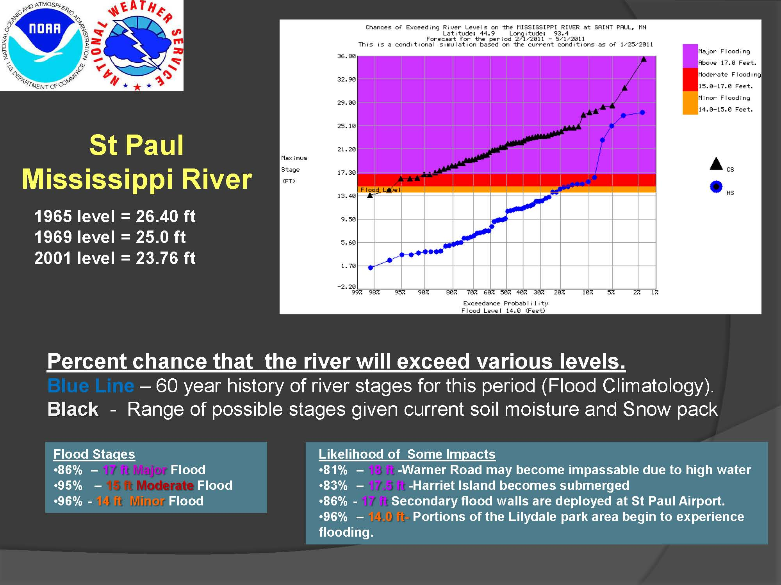

Slide 7
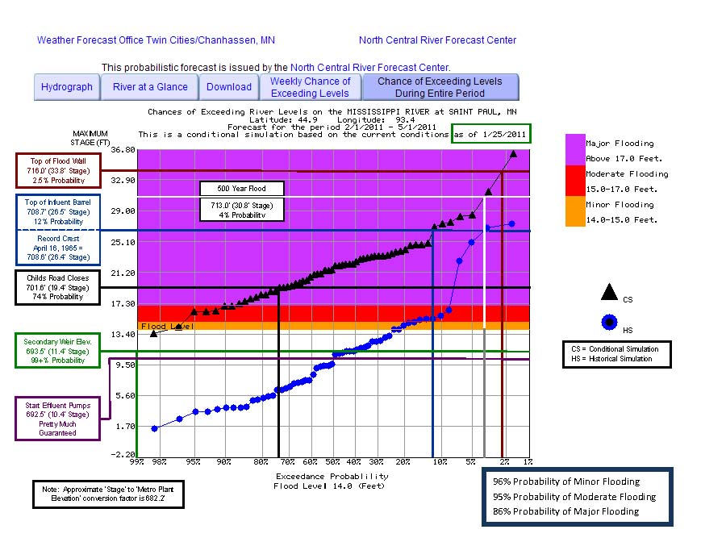
Mississippi River
At St. Paul
Metro Wastewater
Treatment Plant

Slide 8
Metro Plant Flood Preparations
Emergency Generators
Childs Road Ramp (If needed)
Sand Bags & Stop Logs
Meetings with Neighboring Businesses
Coordination with City/County Emergency Offices
Increase Critical Process Chemicals Inventory
Provide 24/7 Electrician and Manager Coverage

Slide 9
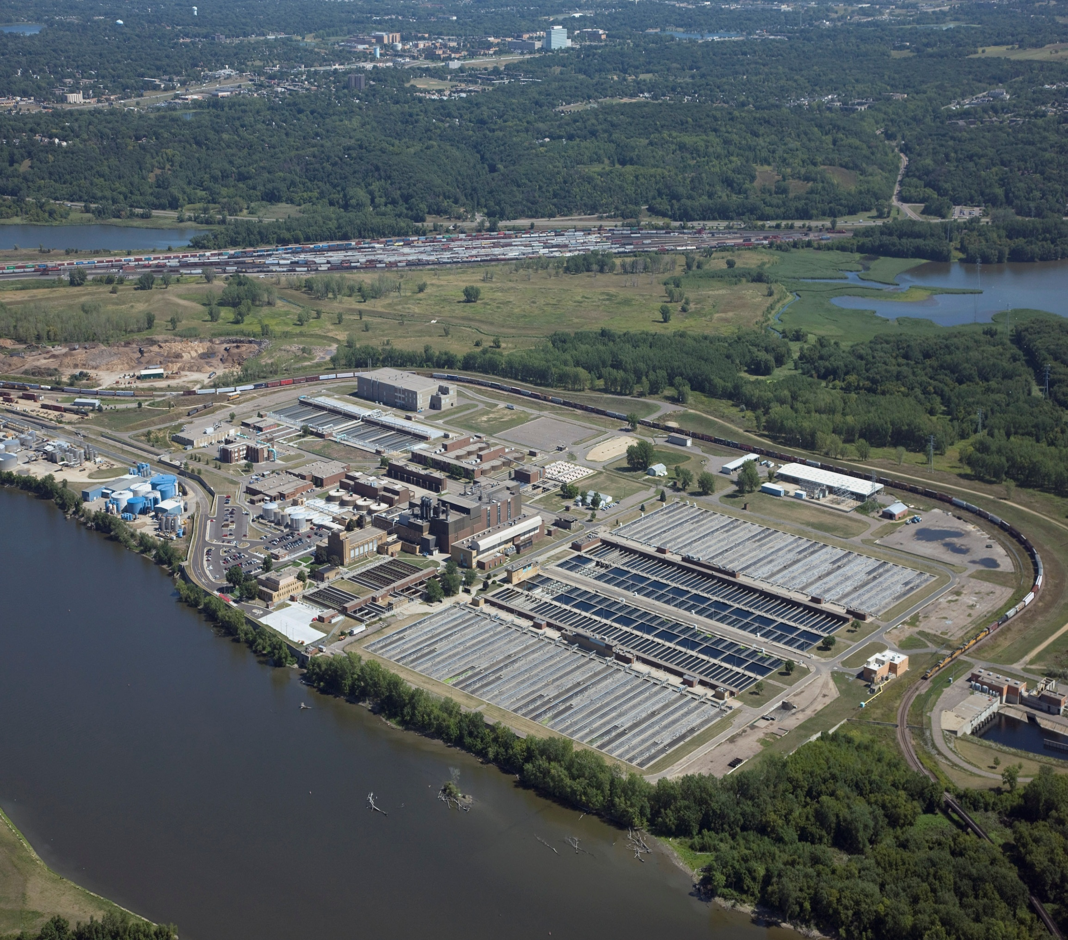

Slide 10
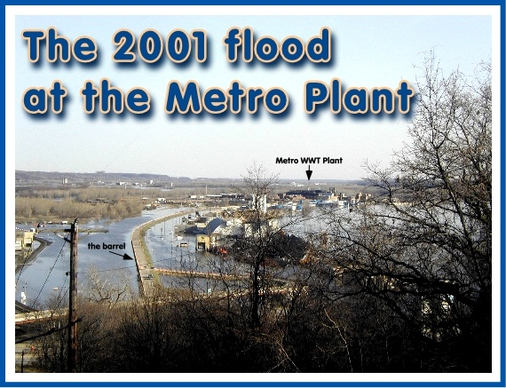

Slide 11
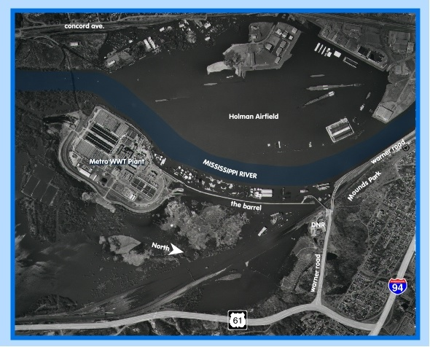

Slide 12
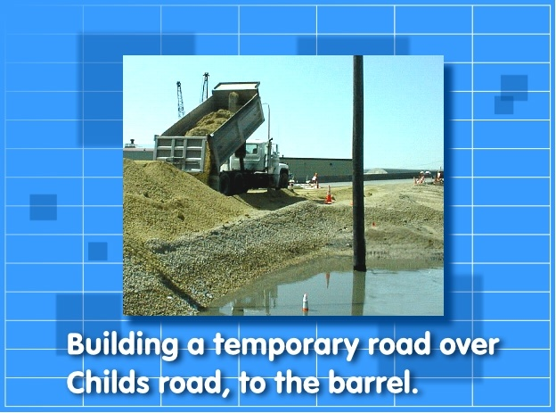

Slide 13
Thank you!
Questions or comments?
Mike Mereness
Metro Plant Director
651-602-8296

Slide 14
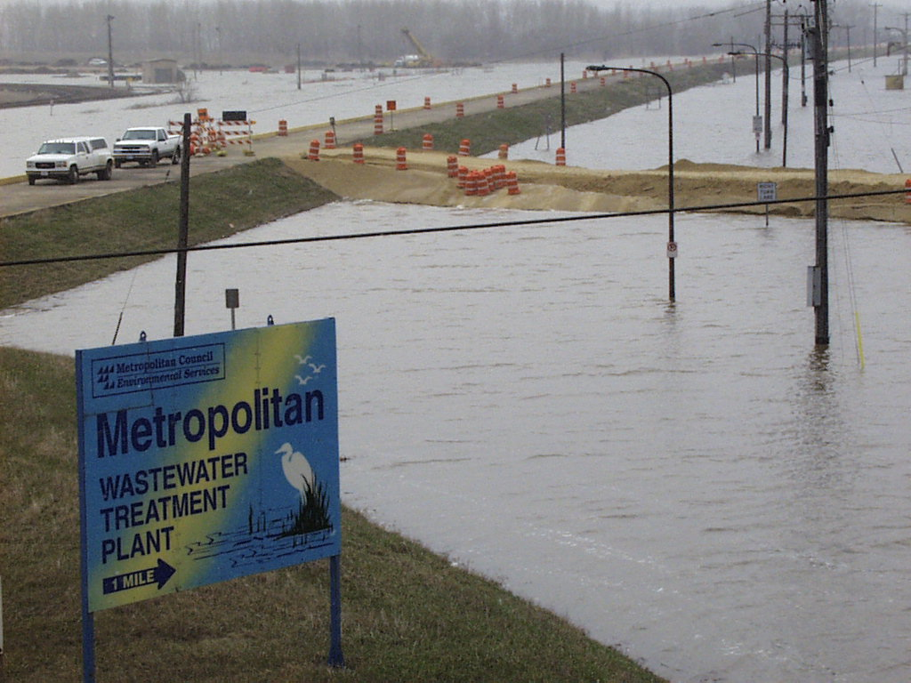
Thank you!
Questions or comments?
Mike Mereness
Metro Plant Director
651-602-8296

Slide 15
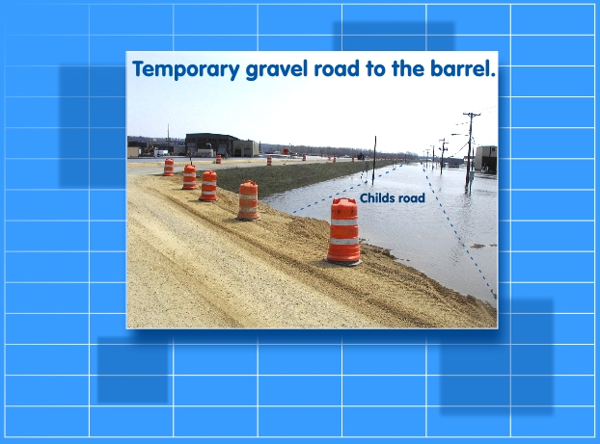

Slide 16
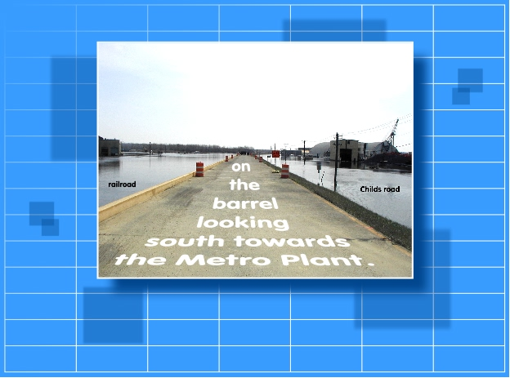

Slide 17
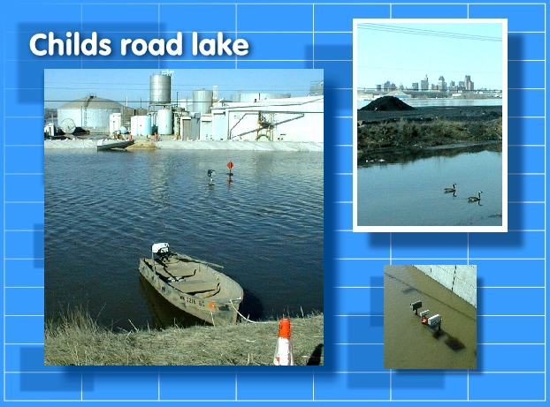

Slide 18


Slide 19
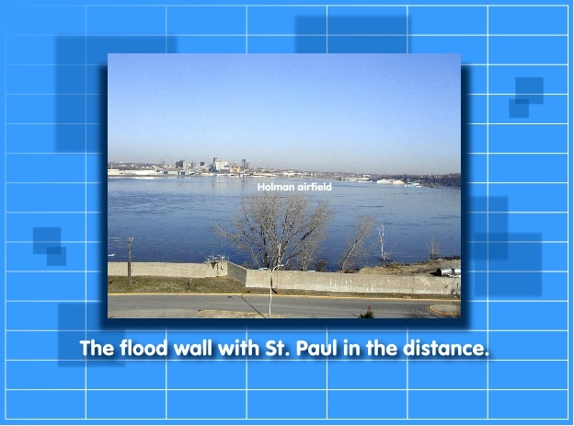

Slide 20
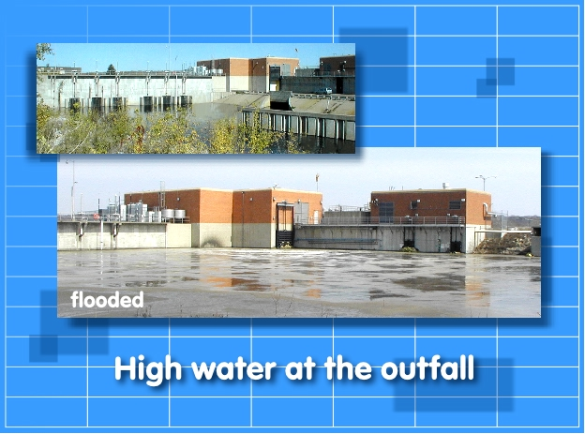
before

Slide 21
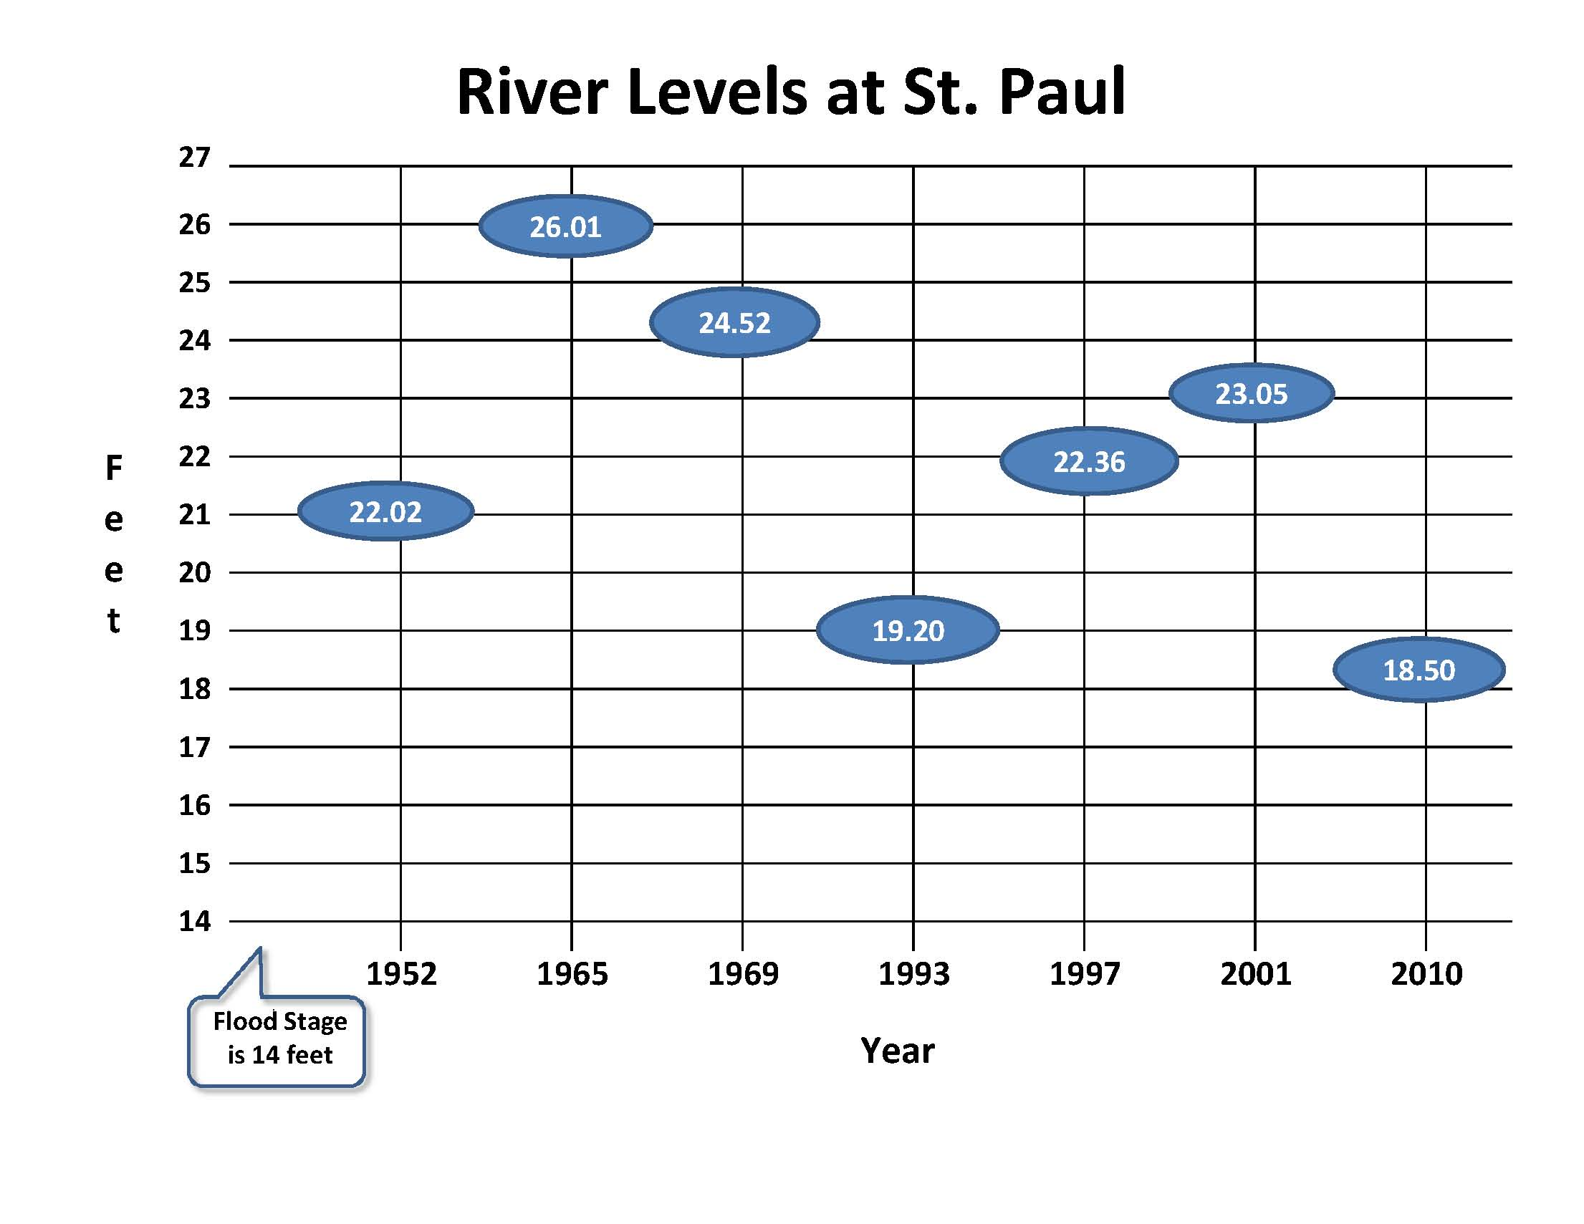


Slide 22
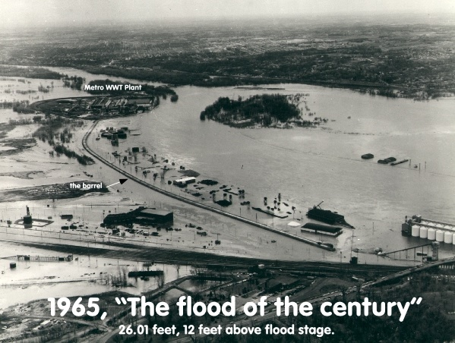

Slide 23
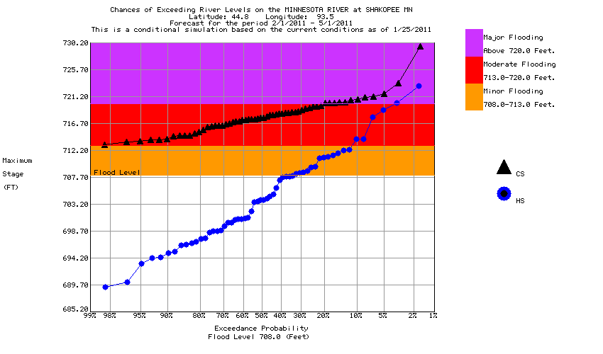
Top of Levee
Add Sand Bags
723.5’
3-4%
Probability
2001 Flood
719’
Start Screw Pumps
710.5’
100% Probability
Fill Empty Tanks
702.0’
100% Probability
Mississippi River
At Shakopee
Blue Lake Wastewater
Treatment Plant

Slide 24
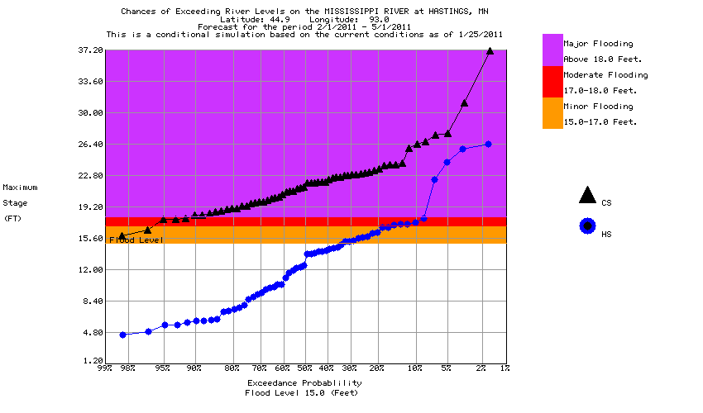
Top of Levee
Add Sand Bags
695.0’
(25‘ Stage)
12% Probability
24/7 Staffing
690.0’
(20.0 ‘ Stage)
60% Probability
2001 Flood
692.5’
Fill Empty Tanks
687.0’
(17.0 ‘ Stage)
95% Probability
Mississippi River
At Hastings
Hastings Wastewater
Treatment Plant

Slide 25
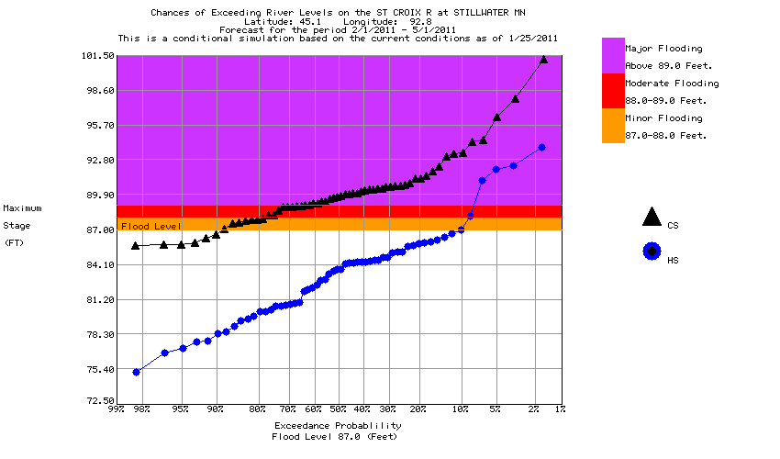
24/7 Staffing
695.0’
(95.0 ‘ Stage)
5% Probability
2001 Flood
692.5’
Night Time Inspections
690.0’
(90.0 ‘ Stage)
20% Probability
St. Croix River
At Stillwater
St. Croix Valley
Wastewater
Treatment Plant

Slide 26
Thank you!
Questions or Comments?
Mike Mereness
Metro Plant Director
651-602-8296

