Slide 1
Gateway Corridor
Alternatives Analysis Findings
Metropolitan Council Transportation Committee
November 26, 2012

Slide 2
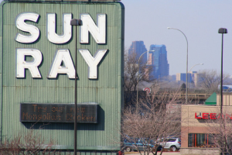
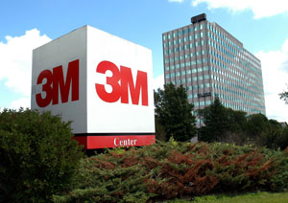
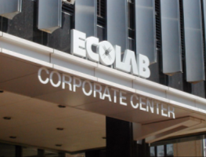
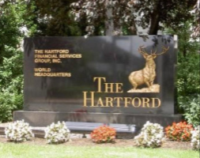
90 Mile Corridor

Slide 3
Project Goals
Tier One
Improve Mobility
Tier Two
Support Economic Development
Provide a Cost-Effective, Economically Viable Transit Option
Protect the Natural Environment
Preserve and Protect Community Quality of Life
Improve Safety
Notes:
FTA:
Mobility Improvements - measured by travel time benefits per project passenger mile, low-income households served, and employment near stations.
Environmental Benefits - measured by change in regional pollutant emissions, change in regional energy consumption, and EPA air quality designation
Cost Effectiveness - measured as the cost per hour of travel time saved.
Operating Efficiencies - measured by system operating cost per passenger mile.
Transit Supportive Land Use & Future Patterns - measured by existing land use, transit supportive plans and policies and performance, and impacts of policies.
Other - includes a number of optional factors, including the projected economic impact of project.

Slide 4
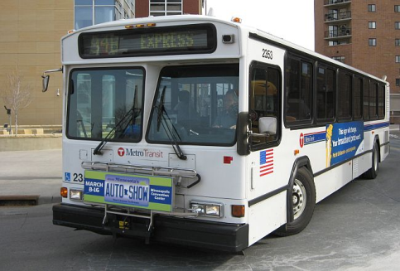
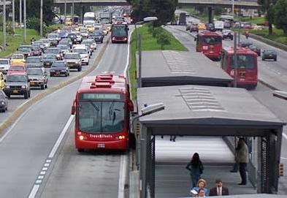
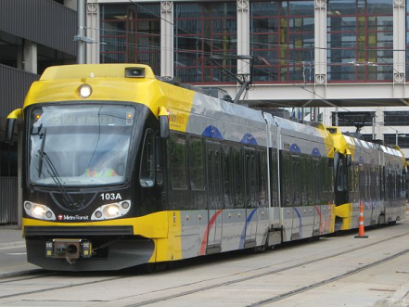
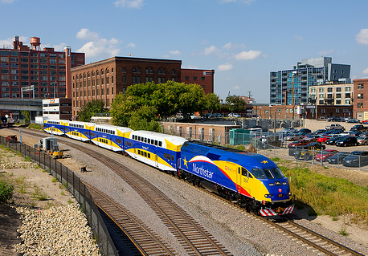
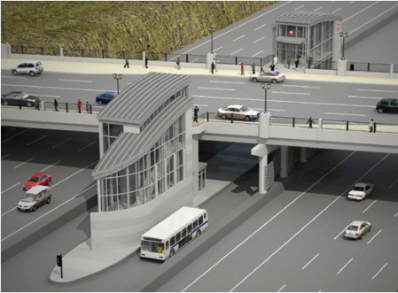
Type of Transit
Express Bus
Bus Rapid Transit (BRT) Guideway
Light Rail Transit (LRT)
Commuter Rail
BRT Managed Lane

Slide 5
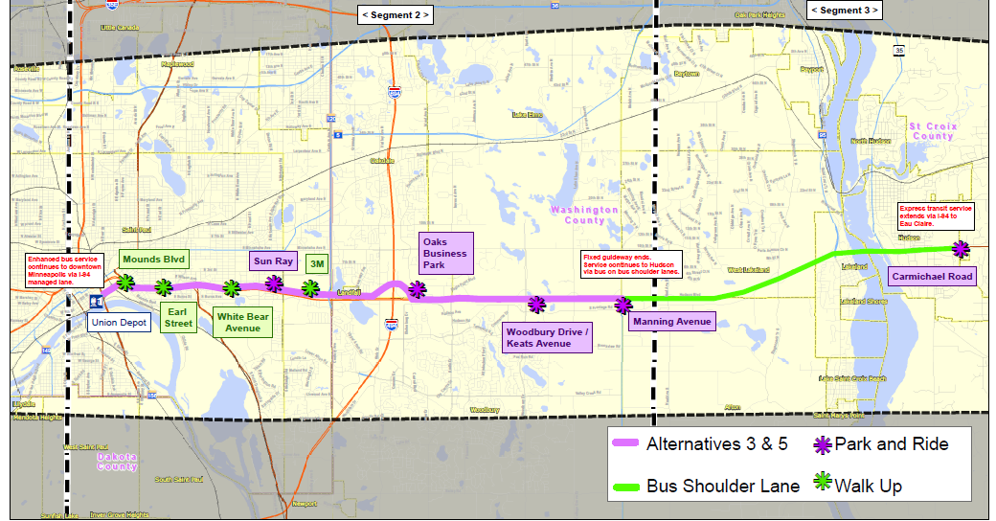
Alternatives 3 & 5:
Hudson Road/I-94 BRT or LRT

Slide 6
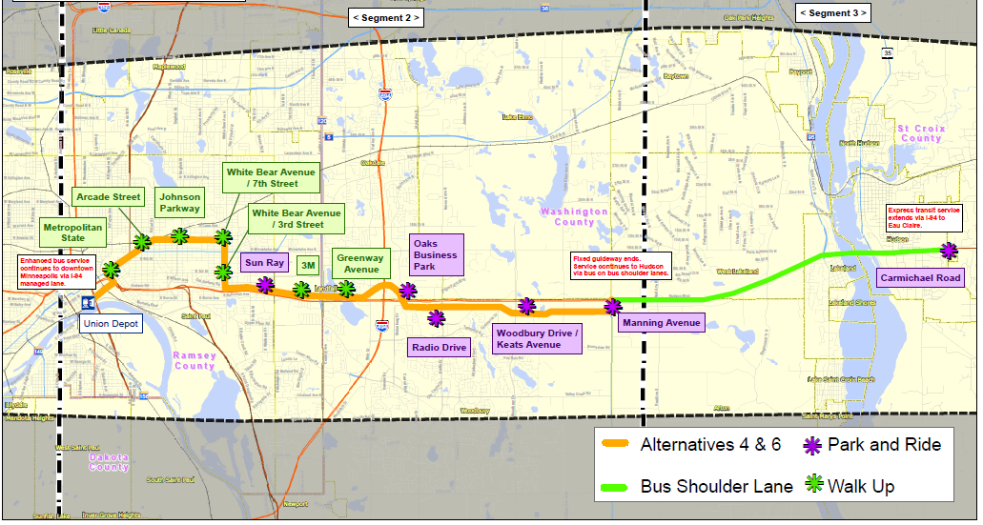
Alternatives 4 & 6:
E. 7th/White Bear/Hudson Road BRT or LRT

Slide 7
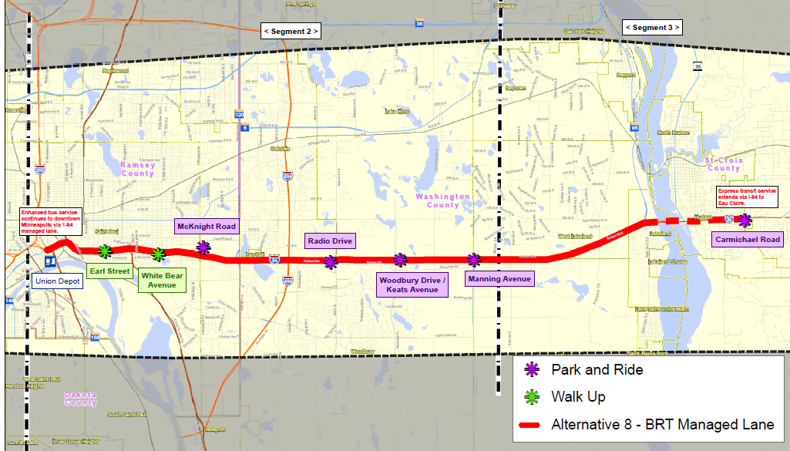
Alternative 8:
BRT Managed Lane
Alternative 8: BRT Managed Lane

Slide 8
Preliminary Ranking of Alternatives – March 2012
Alternative | Ranking
BRT along Hudson Rd/I-94 (Alt 3) | HIGH
BRT Managed Lane (Alt 8) | HIGH
LRT along Hudson Rd/I-94 (Alt 5) | MEDIUM
TSM (Alt 2) | MEDIUM
LRT along St. Paul Streets/Hudson Rd (Alt 6) | LOW
BRT along St. Paul Streets/Hudson Rd (Alt 4) | LOW
Commuter Rail (Alt 7)—Dismissed by Corridor Commission March 15, 2012 | LOW
Notes:
TSM over No Build: 6000
Alt 3 – 1600
Alt 4 – 2000
Alt 5 – 3700
Alt 6 – 3900
Alt 7 – 3000
Alt 8 - 1600

Slide 9
Optimization Work
Look at ways to reduce Impacts and Cost and increase benefits of each alternative
Notes:
Identify and Evaluate Transit Options that:
Benefit and make sense for the Gateway Corridor
Are consistent with the region’s infrastructure and service plans
Corridor communities can support
Are Cost-effective
May qualify for federal capital funding assistance through the Federal Transit Administration (FTA) “New Starts” process

Slide 10
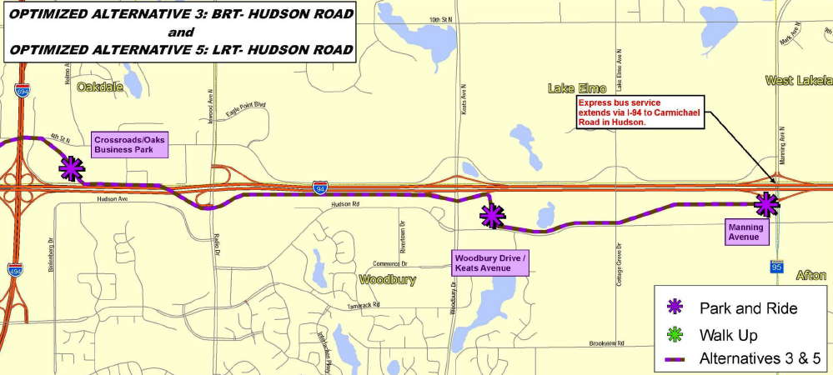
Modifying Alignment of Alternative 3 (BRT) and 5 (LRT)
Shifted to run on the south side of I-94 east of 494/694 interchange
Better economic development potential
More accessible stations

Slide 11
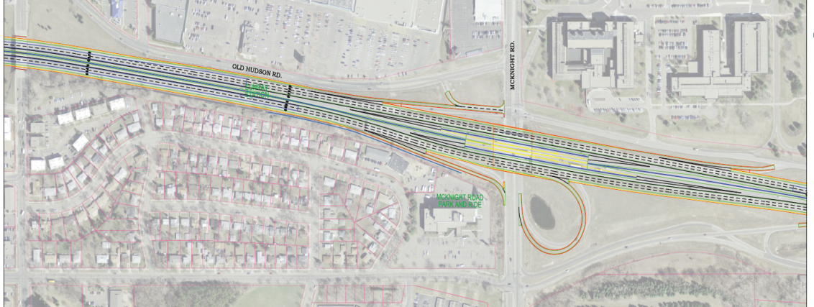
Modifying Stations
Added Landfall Station for Alt 3 (BRT) and 5 (LRT)
Added significant amount of walk up riders
Shifted stations for Alt 8 (BRT Managed Lane)
Better access to SunRay and 3M
White Bear
Station
Ruth
Street
Sun Ray
3M
Shift
Shift
McKnight
Station

Slide 12
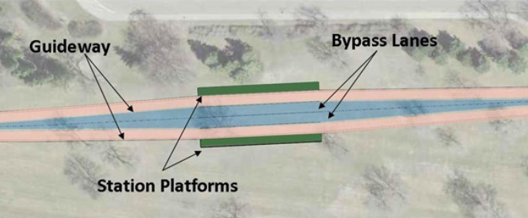
Added BRT Bypass Lanes at Stations for Alt 3 (BRT)
Passing lane added in each direction
Express buses can use fixed guideway and bypass station platforms where a station-to-station BRT bus may be stopped

Slide 13
Changing Transit Service
Improve Efficiency / Reducing Costs
Scaled back WI bus service to Hudson – originally planned all the way to Eau Claire
Reduced off-peak service from every 15 minutes to every 30 minutes

Slide 14
Results
Optimization process has been a huge success resulting in the following notable improvements:
Ridership increased significantly for Optimized Alternative 3 (BRT) and 8 (Managed Lane)
Capital Operating & Maintenance Costs decrease for all Optimized Alternatives
Economic development opportunity increases for Alt 3 (BRT) and 5 (LRT)
Transit Travel Times competitive with automobile on freeway in the rush hour periods
Notes:
Identify and Evaluate Transit Options that:
Benefit and make sense for the Gateway Corridor
Are consistent with the region’s infrastructure and service plans
Corridor communities can support
Are Cost-effective
May qualify for federal capital funding assistance through the Federal Transit Administration (FTA) “New Starts” process

Slide 15
Ridership - Boardings in Corridor
Alternative | Alt 3 BRT | Alt 4 BRT (Local) | Alt 5 LRT | Alt 6 LRT (Local) | Alt 8 BRT (ML)
Original | 5,400 | 5,800 | 9,200 | 10,400 | 4,700
Optimized* | 8,800 / 9,300 | 5,400 | 9,300 | 10,000 | 8,100
*BRT boardings include both express and station to station service on guideway

Slide 16
2019 Optimized vs. Original Capital Cost Estimates
2019 Optimized vs. Original Capital Cost Estimates (in millions) by Alternative

Slide 17
Updated Evaluation Summary
+ = 10 points O = 5 points - = 0 points | Goal 1: Improve Mobility |  |  | Goal 2: Cost Effective, Economically Viable |  | Goal 3: Supports Economic Development |  | Goal 4: Protect Natural Environment | Goal 5: Community Quality of Life | Goal 6: Safety | Overall Ranking
 | Daily Transitway Ridership | Transit Travel Times | Traffic Impacts | 2019 Capital Cost/CEI | Operating Costs | 2010 Population & Employment | Station Area Development Potential | Impact Avoidance/Minimization & VMT Reduction | Property Acquisitions | Ungated, At-Grade Crossings
3 – BRT along Hudson Rd/ I-94 OPTIMIZED | + | + | O | + | O | + | + | + | O | + | High 85 points
5 – LRT along Hudson Rd/ I-94 OPTIMIZED | + | + | O | O | ― | + | + | + | O | + | Medium 75 points
8 – BRT Managed Lane OPTIMIZED | + | + | + | O | O | O | ― | + | + | + | Medium 75 points
2-TSM OPTIMIZED | ― | + | O | + | + | O | ― | + | + | + | Low 70 points
4 – BRT along E 7th/White Bear Ave/Hudson Rd | O | ― | ― | + | ― | + | + | + | ― | O | Low 50 points
6 – LRT along E 7th/White Bear Ave/Hudson Rd | + | ― | ― | ― | ― | + | + | + | ― | O | Low 45 points

Slide 18
Gateway Corridor Commission (GCC) Action
Advance Optimized Alternative 3 – BRT along Hudson Road / I-94 into DEIS as preferred option
Highest Ranked Alternative Overall
Received Medium or High Ranking Under All Project Goals
FTA New Starts Eligible under MAP-21
Advance Optimized Alternative 5 – LRT along Hudson Road / I-94 into DEIS for comparative purposes to BRT
Received low ranking for cost but medium or high ranking for all other goals
Continued evaluation in DEIS allows for side-by-side comparison to BRT
FTA New Starts Eligible under MAP-21

Slide 19
Additional Direction
Do not advance Optimized Alternative 8 – BRT Managed Lane
Fewer Station and location in middle of freeway offer less economic development opportunity compared to other alternatives
Does not qualify for FTA New Starts funding under MAP-21
Alternative 2 advances into DEIS only if required under MAP-21

Slide 20
Next Steps
Upcoming Meetings / Milestones | Date/Time | Purpose
Report Released / 63 Day Comment Period | November 5, 2012 through Jan 3, 2013 | Public Comment on Overall Rankings, Alternatives to Advance, Draft Final Report
Gateway Corridor Commission | January 2013 (Date TBD) | Review Public Comment, Approve AA Final Report
Washington County RRA | January 2013 (Date TBD) | Resolution Supporting findings of AA study
Next Phase: Prepare Environmental Impact Statement 2013-2014

Slide 21
Thank You
Questions/Comments
Andy Gitzlaff, Senior Planner – Acting Planning Coordinator
Washington County
andy.gitzlaff@co.washington.mn.us
651-430-4338

